Slide 1


Modern Operating Systems
Fifth Edition
Chapter 4
File Systems
Copyright © 2023, 2014, 2008 Pearson Education, Inc. All Rights Reserved
Notes:
If this PowerPoint presentation contains mathematical equations, you may need to check that your computer has the following installed:
1) Math Type Plugin
2) Math Player (free versions available)
3) NVDA Reader (free versions available)

Slide 2
File Systems (1)
Three essential requirements for long-term information storage:
It must be possible to store a very large amount of information
Information must survive termination of process using it
Multiple processes must be able to access information concurrently

Slide 3
File Systems (2)
Think of a disk as a linear sequence of fixed-size blocks and supporting two operations:
Read block k.
Write block k

Slide 4
File Systems (3)
Questions that quickly arise:
How do you find information?
How do you keep one user from reading another user’s data?
How do you know which blocks are free?

Slide 5
File Systems (4)
File Systems are:
A way to organize and (persistently) store information
An abstraction over storage devices:
Hard disk, S S D, network, R A M,
Organized in files and (typically) directories.
Examples:
F A T12/F A T16: M S-D O S
N T F S: Windows
Ext4: Linux
A P F S: mac O S/i O S

Slide 6
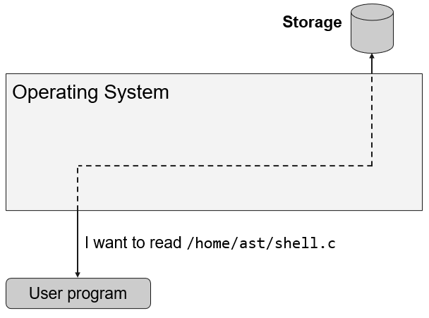
Overview (1 of 4)
Notes:
Long Description:
The storage is represented in the form of a cylinder on the top right of the diagram. A rectangular box is at the center labeled as operating system. The user program is at the bottom of the diagram. A double-headed arrow is pointing towards the user program and the storage by passing through the rectangular box of operating system in the form of dashed lines. Text beside the arrow reads, I want to read slash home slash ast slash shell dot c.

Slide 7
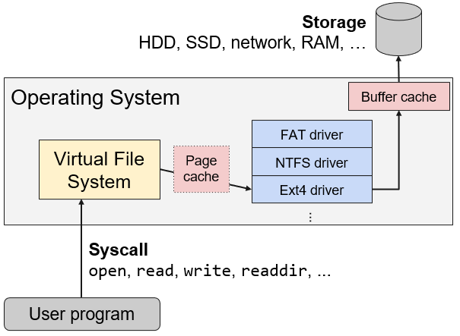
Overview (2 of 4)
Notes:
Long Description:
The flow chart labeled from bottom to top is as follows. User program; syscall of open, read, write, readdir, ellipsis; virtual file system; page cache, F A T driver, N T F S driver and E x t 4 driver; buffer cache; storage of H D D, S S D, network, R A M, ellipsis. The virtual file system, page cache, F A T driver, N T F S driver and E x t 4 driver, and buffer cache are part of the operating system.

Slide 8
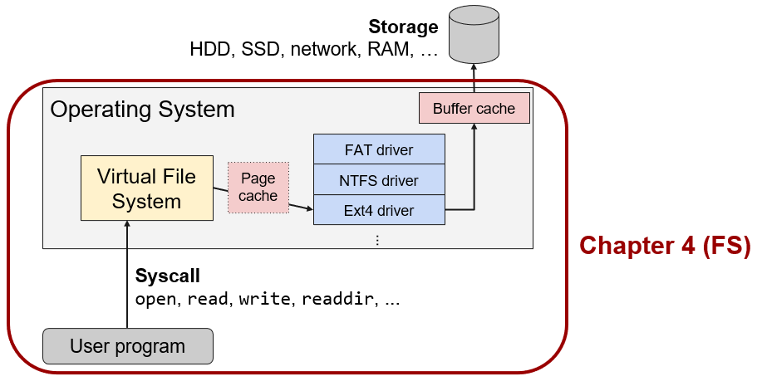
Overview (3 of 4)
Notes:
Long Description:
The flow chart labeled from bottom to top is as follows. User program; syscall of open, read, write, readdir, ellipsis; virtual file system; page cache, F A T driver, N T F S driver and E x t 4 driver; buffer cache; storage of H D D, S S D, network, R A M, ellipsis. The virtual file system, page cache, F A T driver, N T F S driver and E x t 4 driver, and buffer cache are part of the operating system. The operating system and the user program are inside a rectangular box with red border and curved edges. The box is further labeled as chapter 4 open parenthesis F S close parenthesis.

Slide 9
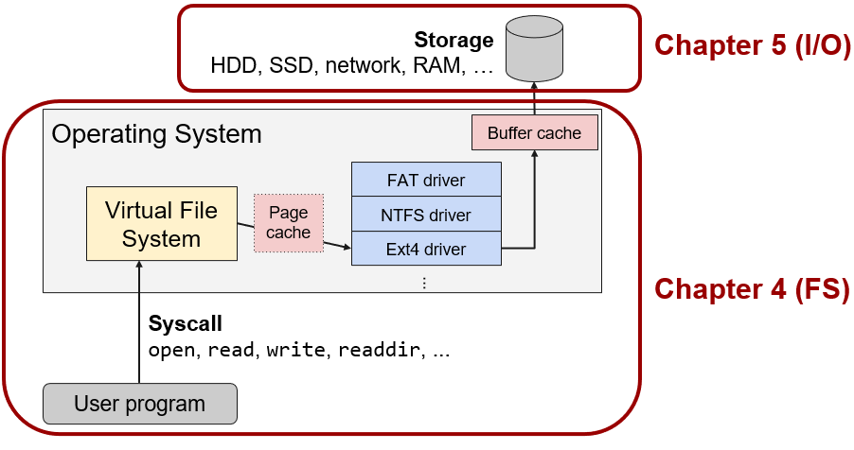
Overview (4 of 4)
Notes:
Long Description:
The flow chart labeled from bottom to top is as follows. User program; syscall of open, read, write, readdir, ellipsis; virtual file system; page cache, F A T driver, N T F S driver and E x t 4 driver; buffer cache; storage of H D D, S S D, network, R A M, ellipsis. The virtual file system, page cache, F A T driver, N T F S driver and E x t 4 driver, and buffer cache are part of the operating system. The operating system and the user program are inside a rectangular box with red border and curved edges. The box is further labeled as chapter 4 open parenthesis F S close parenthesis. The storage is also marked inside a rectangular box with red border and curved edges and is labeled as chapter 5 open parenthesis I forward slash O close parenthesis.

Slide 10
Files
Abstract storage nodes
File access:
Sequential versus. random access
File types:
Regular files, directories, soft links
Special files (e.g., device files, metadata files)
File structure:
O S’ perspective: Files as streams of bytes
Program’s perspective: Archives, Executables, etc.

Slide 11
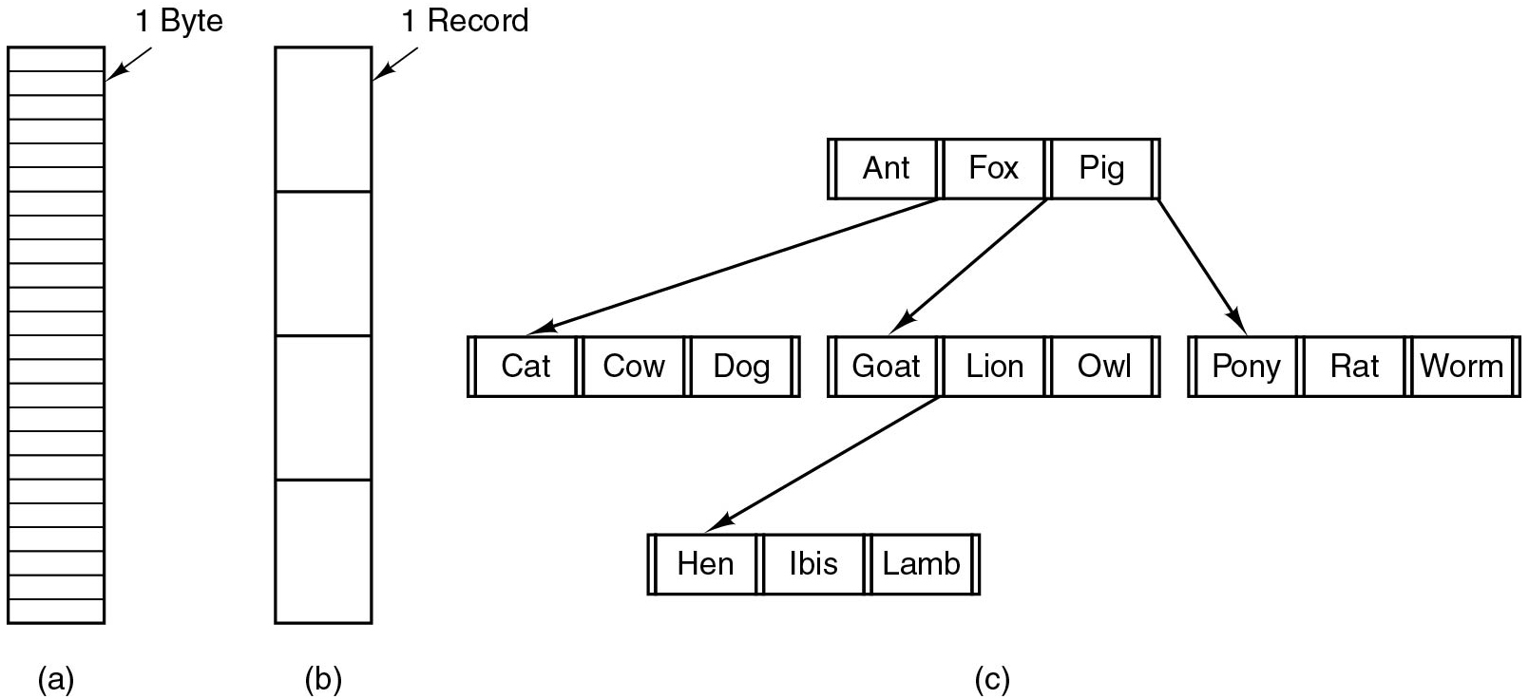
File Structure
Figure 4.2 Three kinds of files. (a) Byte sequence. (b) Record sequence. (c) Tree.
Notes:
Long Description:
Part (a): There is a vertical rectangular block with multiple partitions labeled 1 Byte. Part (b): A vertical rectangular block has four partitions labeled 1 Record. Part (c): A horizontal rectangular block has three partitions labeled Ant, Fox, and Pig from left to right. There are three downward arrows as follows: An arrow from the first block points to the other three blocks having three partitions labeled Cat, Cow, and Dog. An arrow from the second block points to the other three blocks having three partitions labeled Goat, Lion, and Owl. An arrow from the third block points to the other three blocks having three partitions labeled Pony, Rat, and Worm. An arrow from the Goat block points to the fifth block having three partitions labeled Hen, Ibis, and Lamb.

Slide 12
Quiz (1 of 6)
When does the O S itself care about the contents of a file?

Slide 13
Answer to Quiz (1 of 6)
Q: When does the O S itself care about the contents of a file?
A: Only when the O S uses the file itself (directories, executables, boot image, etc.)

Slide 14
File Naming (1 of 2)
Different file systems have different limitations/conventions for file names
File extensions
File name length
characters (later extended to 255)
characters
Special characters in file names
and more
or the special names
and
Case sensitivity

Slide 15
File Naming (2 of 2)
Extension | Meaning
.b a k | Backup file
.c | C source program
.g i f | Compuserve Graphical Interchange Format image
.h t m l | World Wide Web HyperText Markup Language document
.j p g | Still picture encoded with the J P E G standard
.m p 3 | Music encoded in M P E G layer 3 audio format
.m p g | Movie encoded with the M P E G standard
.o | Object file (compiler output, not yet linked)
.p d f | Portable Document Format file
.p s | PostScript file
.t e x | Input for the T E X formatting program
.t x t | General text file
.z i p | Compressed archive
Figure 4.1 Some typical file extensions.

Slide 16
Quiz (2 of 6)
$ cat hello.c
hash include <stdio.h>
void main() {
printf("Hello, world\n");
}
$ gcc -o hello.pdf hello.c
$ file hello.pdf
hello.pdf: E L F 64-bit L S B shared object, x86-64, version 1 (S Y S V) [...]
$ ./hello.pdf
Hello, world
How does the O S know `hello.pdf` is not really a P D F file?

Slide 17
Answer to Quiz (2 of 6)
$ cat hello.c
#include <stdio.h>
void main() {
printf("Hello, world\n");
}
$ gcc -o hello.pdf hello.c
$ file hello.pdf
hello.pdf: E L F 64-bit L S B shared object, x86-64, version 1 (S Y S V) [...]
$ ./hello.pdf
Hello, world
Q: How does the O S know `hello.pdf` is not really a P D F file?
A: It doesn’t but if you try to execute it and it is a valid executable, it will be started and run. Of course, Acrobat will recognize it as an invalid file.

Slide 18
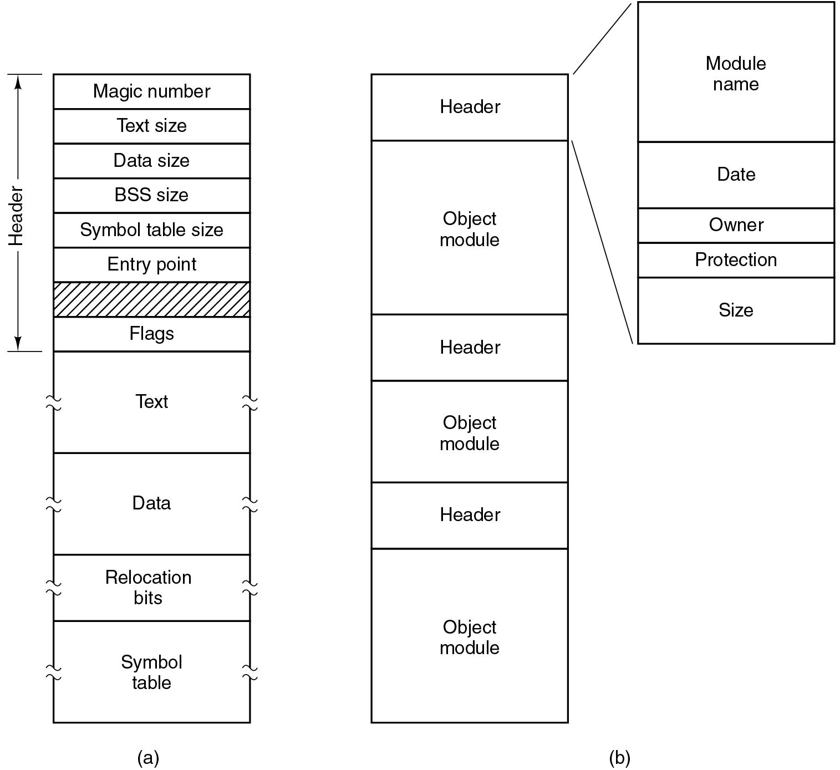
File Types
Figure 4.3 (a) An executable file. (b) An archive
Notes:
Long Description:
Part (a): A vertical block has twelve partitions. The first six partitions from top to bottom are labeled Magic number, text size, data size, BSS size, Symbol table size, entry point. The seventh partition is shaded with diagonal lines. Eighth to twelfth partitions are labeled Flags, text, data, relocation bits, and symbol table. The first Eight partitions are labeled Header. Part (b): A vertical block has six partitions. The partitions from top to bottom are labeled Header, Object module, Header, Object Module, Header, and Object Module. The Header of the vertical block expands to another vertical block having five partitions. The five partitions are labeled Module name, Date, Owner, Protection, and size from top to bottom.

Slide 19
File Attributes (1)
Attribute | Meaning
Protection | Who can access the file and in what way
Password | Password needed to access the file
Creator | I D of the person who created the file
Owner | Current owner
Read-only flag | 0 for read/write; 1 for read only
Hidden flag | 0 for normal; 1 for do not display in listings
System flag | 0 for normal files; 1 for system file
Archive flag | 0 for has been backed up; 1 for needs to be backed up
A S C I I/binary flag | 0 for A S C I I file; 1 for binary file
Random access flag | 0 for sequential access only; 1 for random access
Figure 4.5 Some possible file attributes.

Slide 20
File Attributes (2)
Attribute | Meaning
Temporary flag | 0 for normal; 1 for delete file on process exit
Lock flags | 0 for unlocked; nonzero for locked
Record length | Number of bytes in a record
Key position | Offset of the key within each record
Key length | Number of bytes in the key field
Creation time | Date and time the file was created
Time of last access | Date and time the file was last accessed
Time of last change | Date and time the file was last changed
Current size | Number of bytes in the file
Maximum size | Number of bytes the file may grow to
Figure 4.5 Some possible file attributes.

Slide 21
File Operations (1)
Create
Delete
O p
Close
Read
Write
Append
Seek
Get attributes
Set attributes
Rename

Slide 22
File Operations – U N I X (1)
Opening and reading file:
int fd = open(“foo.txt”, O_RDONLY);
char buf[512];
ssize_t bytes_read = read(fd, buf, 512);
close(fd);
printf(“read %zd: %s\n”, bytes_read, buf);
Opening a file returns a handle (file descriptor) for future operations.
Any function may return an error, e.g.:
E N O E N T: File does not exist
E B A D F: Bad file descriptor

Slide 23
File Operations – U N I X (2)
Seeking in files:
int fd = open(“foo.txt”, O_RDONLY);
lseek(fd, 128, SEEK_CUR);
char buf[8];
read(fd, buf, 8);
close(fd);
Move current position in file forwards or backwards.

Slide 24
File Operations – U N I X (3)
Writing files:
int fd = open(“foo.txt”, O_WRONLY | O_CREAT | O_TRUNC);
char buf[] = “Hi there”;
write(fd, buf, strlen(buf));
close(fd);
O_C R E A T: Create file if it does not exist
O_T R U N C: “Truncate” file to size 0 if it exists (i.e., throw away current file contents)

Slide 25
File Operations – U N I X (4)
Removing file:
unlink(“foo.txt”);
Renaming file:
rename(“foo.txt”, “bar.txt”);
Change file permission attribute:
c h mod(“foo.txt”, 0755);
Change file owner attribute:
c h o w n(“foo.txt”, u i d, g i d);

Slide 26
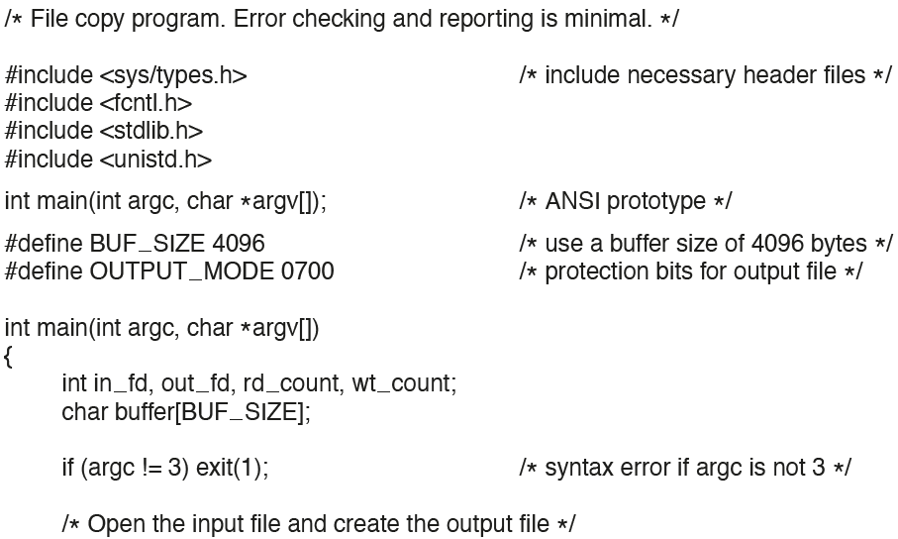
Example Program Using File System Calls (1)
Figure 4.6 A simple program to copy a file.
Notes:
Long Description:
The code from top to bottom is as follows
forward slash asterisk file copy program period Error checking and reporting is minimal period asterisk forward slash
hashtag include less than s y s forward slash types dot h greater than forward slash asterisk include necessary header files asterisk forward slash
hashtag include less than fcntl dot h greater than
hashtag include less than stdlib dot h greater than
hashtag less than unistd dot h greater than
int main open parenthesis int arg c comma char asterisk arg v left square bracket right square bracket close parenthesis semicolon forward slash asterisk A N S I prototype asterisk forward slash
hashtag define B U F underscore S I Z E 4096 forward slash asterisk use a buffer size of 4096 bytes asterisk forward slash
hashtag O U T P U T underscore M O D E 0700 forward slash asterisk protection bits for output file asterisk forward slash
int main open parenthesis int arg c comma char asterisk arg v left square bracket right square bracket close parenthesis
left curly bracket
int in underscore f d comma out underscore f d comma r d underscore count comma w t underscore count semicolon
char buffer left square bracket B U F underscore S I Z E right square bracket semicolon
if open parenthesis arg c exclamation equals to 3 close parenthesis exit open parenthesis 1 close parenthesis semicolon forward slash asterisk syntax error if arg c is not 3 asterisk forward slash
forward slash asterisk open the input file and create the output file asterisk forward slash.

Slide 27
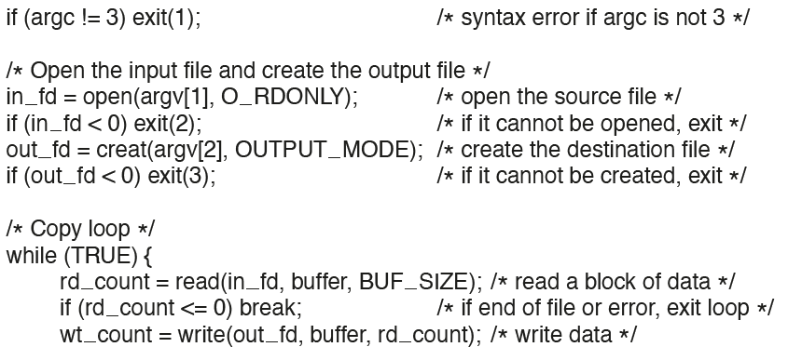
Example Program Using File System Calls (2)
Figure 4.6 A simple program to copy a file.
Notes:
Long Description:
The code from top to bottom is as follows
if open parenthesis arg C exclamation equals to 3 close parenthesis exit open parenthesis 1 close parenthesis semicolon forward slash asterisk syntax error if arg c is not 3 asterisk forward slash
forward slash asterisk open the input file and create the output file asterisk forward slash
in underscore f d equals to open open parenthesis arg v left square bracket 1 right square bracket comma O underscore R D O N L Y close parenthesis semicolon forward slash asterisk open the source file asterisk forward slash
if open parenthesis in underscore f d less than 0 close parenthesis exit open parenthesis 2 close parenthesis semicolon forward slash asterisk if it cannot be opened comma exit asterisk forward slash
out underscore f d equals to creat open parenthesis arg v left square bracket 2 right square bracket comma O U T P U T underscore M O D E close parenthesis semicolon forward slash asterisk create the destination file asterisk forward slash
if open parenthesis out underscore f d less than 0 exit open parenthesis 3 close parenthesis semicolon forward slash asterisk if it cannot be created comma exit asterisk forward slash
forward slash asterisk copy loop asterisk forward slash
while open parenthesis T R U E close parenthesis left curly bracket
r d underscore count equals to read open parenthesis in underscore f d comma buffer comma B U F underscore S I Z E close parenthesis semicolon forward slash asterisk read a block of data asterisk forward slash
if open parenthesis r d underscore count less than equals to 0 close parenthesis break semicolon forward slash asterisk if end of file or error comma exit loop asterisk forward slash
w t underscore count equals to write open parenthesis out underscore f d comma buffer comma r d underscore count close parenthesis semicolon forward slash asterisk write data asterisk forward slash.

Slide 28
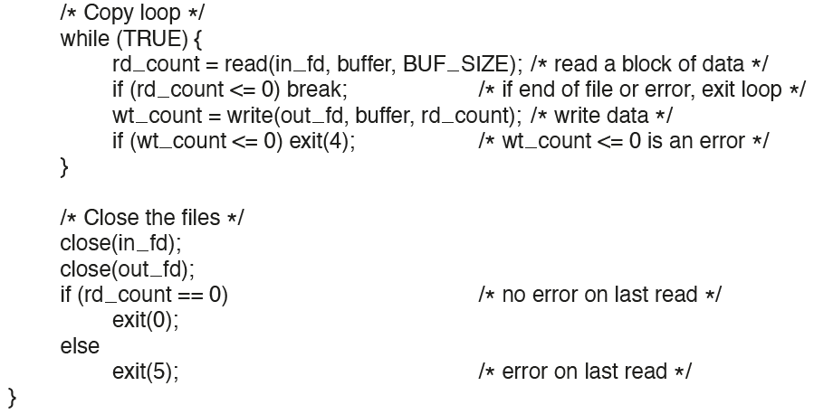
Example Program Using File System Calls (3)
Figure 4.6 A simple program to copy a file.
Notes:
Long Description:
The code from top to bottom is as follows
forward slash asterisk copy loop asterisk forward slash
while open parenthesis T R U E close parenthesis left curly bracket
r d underscore count equals to read open parenthesis in underscore f d comma buffer comma B U F underscore S I Z E close parenthesis semicolon forward slash asterisk read a block of data asterisk forward slash
w t underscore count equals to write open parenthesis out underscore f d comma buffer comma r d underscore count close parenthesis semicolon forward slash asterisk write data asterisk forward slash
if open parenthesis w t underscore count less than equals to 0 close parenthesis exit open parenthesis 4 close parenthesis semicolon forward slash asterisk w t underscore count less than equals to 0 is an error asterisk forward slash
right curly bracket
forward slash asterisk close the files asterisk forward slash
close open parenthesis in underscore f d close parenthesis semicolon
close open parenthesis out underscore f d close parenthesis semicolon
if open parenthesis r d underscore count double equals to 0 close parenthesis forward slash asterisk no error on last read asterisk forward slash
else
exit open parenthesis 5 close parenthesis semicolon forward slash asterisk error on last read asterisk forward slash
right curly bracket.

Slide 29
Directories
Data structures organizing and maintaining information about files
Often stored as file entries with special attributes
Directories are denoted by “/” (Unix) or “\” (Windows)
Special directory entries:
. Current directory
.. Parent directory

Slide 30
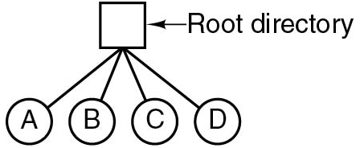
Single-Level Directory Systems
Figure 4.7 A single-level directory system containing four files.
Notes:
Long Description:
A tree starts with a square box labeled Root directory. The Root directory has four possibilities depicted by circles labeled A, B, C, and D from left to right.

Slide 31
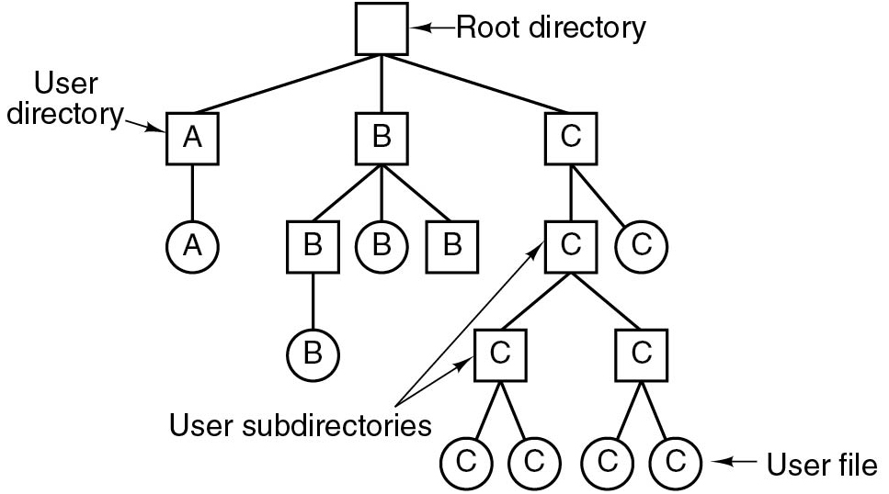
Hierarchical Directory Systems
Figure 4.8 A hierarchical directory system.
Notes:
Long Description:
A tree starts with a square box labeled Root directory. Level 1: The root directory has three possibilities labeled "A", B, and C from left to right depicted by square boxes. "A" is labeled User directory. Level 2: "A" has a possibility labeled "A" labeled within the circle. B has three possibilities labeled B, B, and B from left to right. The left and right possibilities are in square boxes whereas the center is in a circle. C has two possibilities: left in the square box labeled C, which is categorized as User subdirectories and right in the circle labeled C. Level 3: Level 2 B possibility has a possibility B in the circle. Level 2 C possibility has two possibilities C and C in the square box and is categorized as User subdirectories. Level 4: Level 3 C possibilities have two possibilities each, labeled C and C in the circle and categorized as User file.

Slide 32
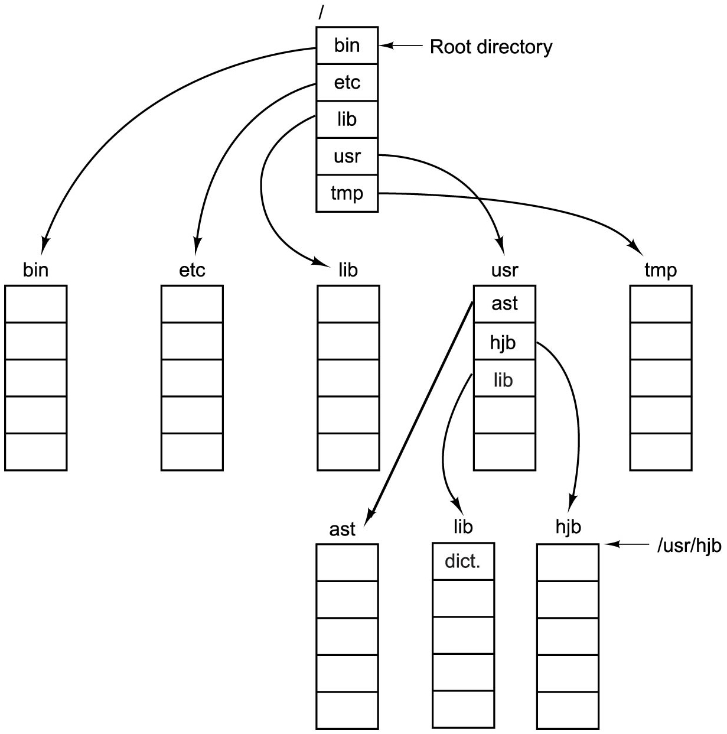
Path Names
Figure 4.9 A U N I X directory tree.
Notes:
Long Description:
A vertical block labeled backslash has five partitions from the top to bottom labeled bin, etc, lib, usr, and tmp and categorized as the Root directory. Five downward arrows from the first vertical block point to further five vertical blocks labeled bin, etc, lib, usr, and tmp with five partitions. The usr block has the first three partitions labeled ast, hjb, lib, and the other two blocks are empty. An arrow from ast points to a vertical block labeled ast with five partitions. An arrow from lib points to a vertical block labeled lib with five partitions in which the first partition is labeled dict. An arrow from hjb points to a vertical block labeled hjb with five partitions and is categorized as /usr/hjb. The blocks labeled bin, etc, temp are blank and have five partitions.

Slide 33
Directory Operations
Create
Delete
Opendir
Closedir
Readdir
Rename
Link
Unlink

Slide 34
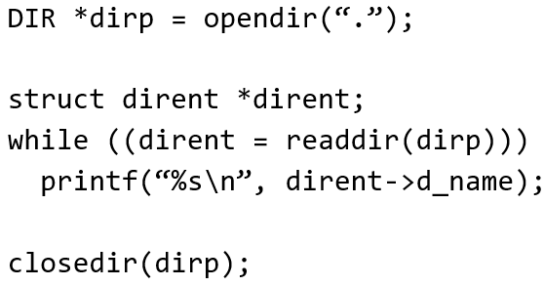
Directory Operations - U N I X
Reading current directory contents:
Notes:
Long Description:
The code from top to bottom is as follows
D I R asterisk d i r p equals to opendir open parenthesis open double quotation dot close double quotation close parenthesis semicolon
struct dirent asterisk dirent semicolon
while double open parenthesis dirent equals to readdir open parenthesis d i r p triple close parenthesis
printf open parenthesis open double quotation percent s backslash n close double quotation comma dirent hyphen greater than d underscore name close parenthesis semicolon
c l o s e d i r open parenthesis d i r p close parenthesis semicolon.

Slide 35
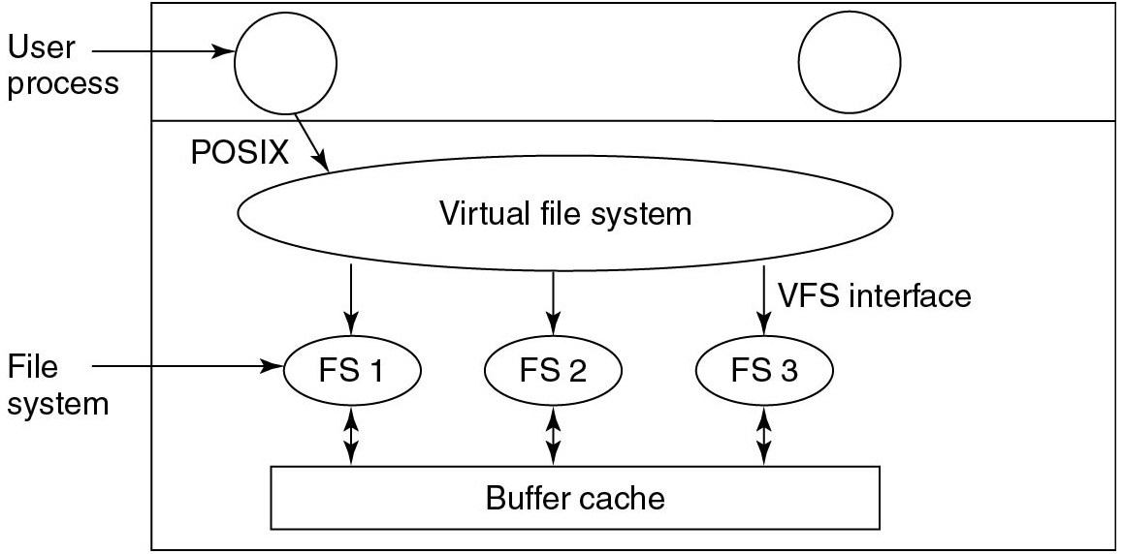
Virtual File Systems (1)
Figure 4.21 Position of the virtual file system.
Notes:
Long Description:
A rectangular block with one horizontal partition. In the first partition, there are two circles labeled User Process. In the second partition, there is a horizontal ellipse labeled Virtual file system. User process points to the virtual file system and is labeled POSIX. A virtual file system with three forward arrows labeled V F S interface points to three small ellipses labeled F S 1, F S 2, and F S 3, and these are labeled File system. From the file system, there are three bidirectional arrows that point to the Buffer Cache block.

Slide 36
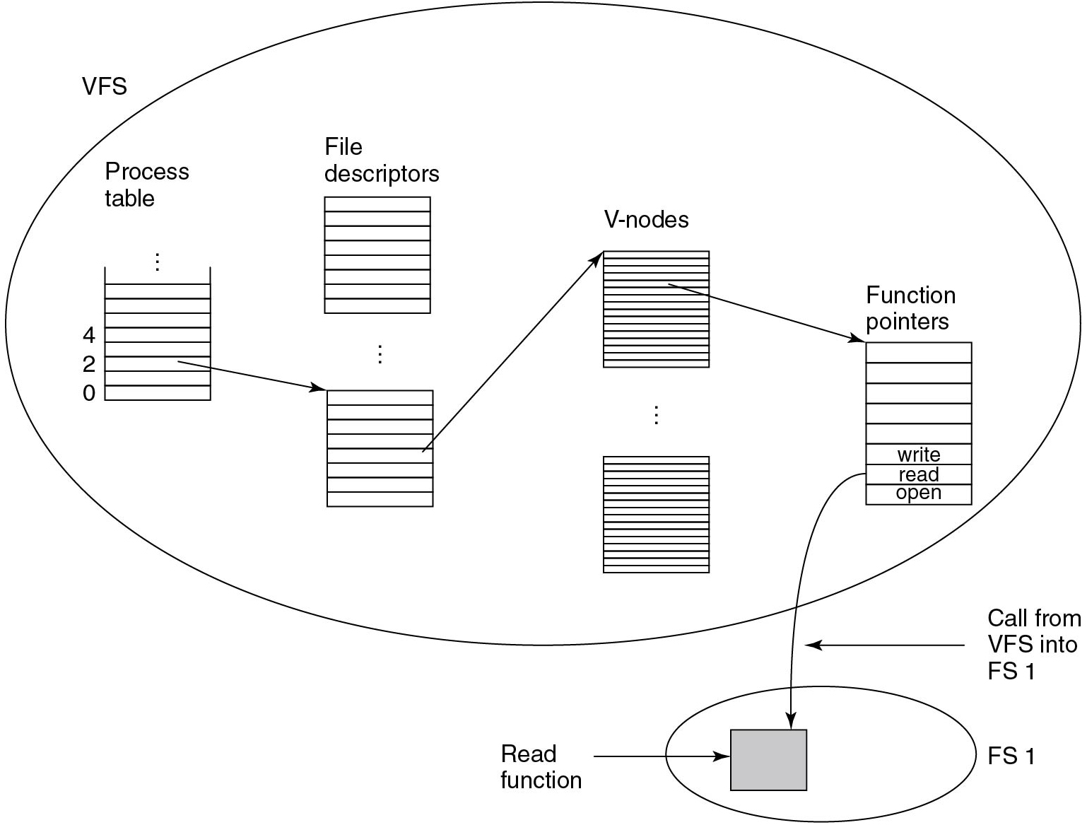
Virtual File Systems (2)
Figure 4.22 A simplified view of the data structures and code used by the V F S and concrete file system to do a read.
Notes:
Long Description:
A large ellipse labeled V F S has the following inside it: A Process table with multiple entries and some entries are labeled 0, 2, 4; An arrow from process table points to File descriptor block having several partitions. An arrow from File descriptor block points to V-nodes block having several partitions. An arrow from the V-nodes block further points to Function pointers block having several partitions in which the last three partitions are labeled write, read, and open. A small eclipse outside the large ellipse and placed at the lower right end. This small ellipse is labeled FS1. A small square inside FS1 is labeled Read Function. An arrow labeled Call from VFS into FS1 from Function pointers points to Read Function.

Slide 37
File System Implementation (1 of 6)
How to store files?
How to implement directories?
How to manage disk space?
How to ensure file system performance?
How to ensure file system dependability?

Slide 38
File System Implementation (2 of 6)
How to store files?
How to implement directories?
How to manage disk space?
How to ensure file system performance?
How to ensure file system dependability?

Slide 39
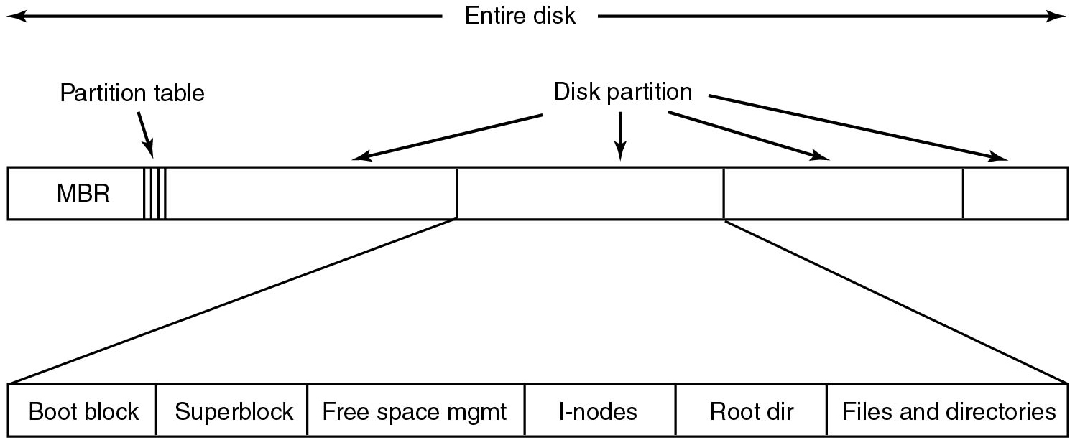
File System Layout
Figure 4.10 A possible file system layout.
Notes:
Long Description:
A horizontal block labeled Entire disk with four partitions labeled Disk partition. The first partition is labeled M B R, there are three vertical lines labeled Partition table in the first partition. The first block points to another horizontal block with six partitions from left to right labeled Boot block, Superblock, Free Space mgmt, I-nodes, Root dir, and Files and directories.

Slide 40
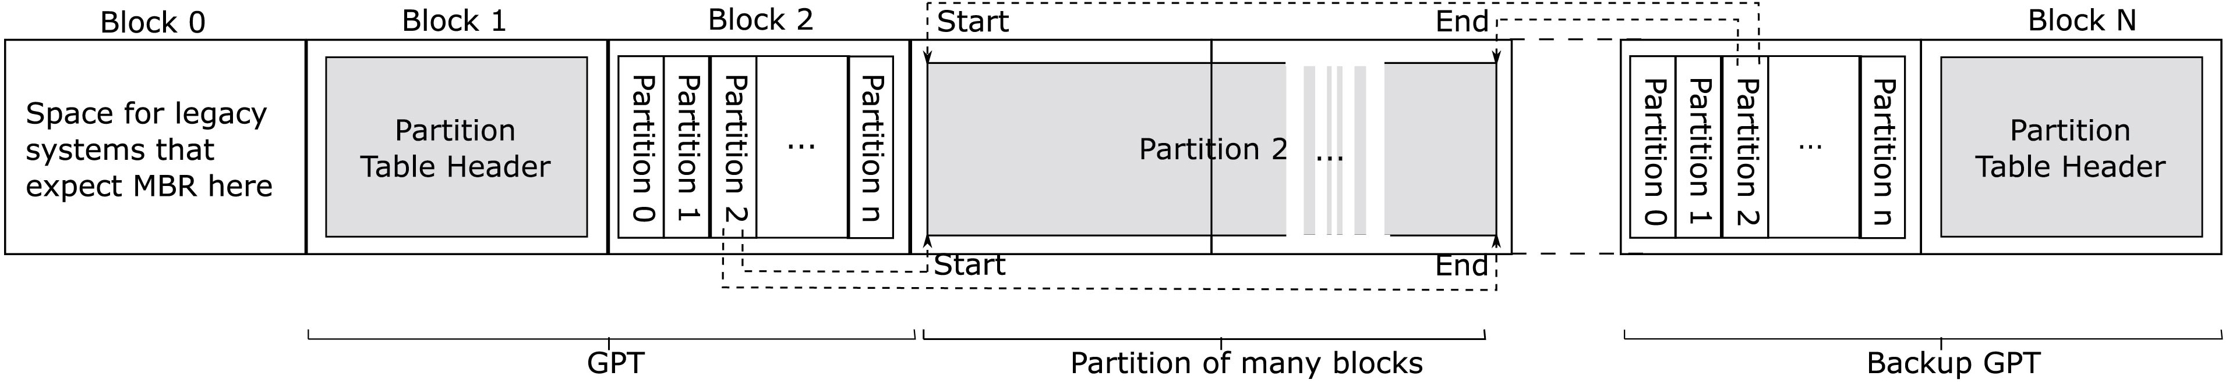
Unified Extensible Firmware Interface (U E F I)
Figure 4.11 Layout for U E F I with partition table
Notes:
Possible layout for U E F I with partition table. Block 0 contains space for legacy systems that expect M B R here. Block 1 contains Partition Table Header. Block 2 contains partitions numbered 0 through n. Partition 2 has a start and end followed by partitions numbered 0 through n.. Block n contains Partition Table Header.
Long Description:
A horizontal block has multiple partitions from Block 0 to Block N. Block 0 is labeled space for legacy systems that expect M B R here. Block 1 has further a square-shaped box inside it and labeled Partition Table Header. Block 2 has further a rectangle-shaped block with multiple partitions from partition 0 to partition n. Block 1 and Block 2 are categorized as G P T. Partition 2 is elaborated and categorized as Partition of many blocks. The partition of many blocks is labeled Start at its upper and lower left ends, and is labeled End at its upper and lower right ends. A dashed line from partition 2 of block 2 partitions points to the Start of Partition of many blocks. A dashed line from partition 2 of block 2 partitions points to the End of Partition of many blocks. Dotted line between this block and the next block depicts the presence of several blocks in between. Block N has further a square-shaped box labeled Partition Table Header inside it. On the left, a box has n partitions labeled Partition 1 to Partition n. A dashed line from Start on the upper left of Partition of many blocks points to the Partition 2 of Block N. A dashed line from End on the upper right of Partition of many blocks points to the Partition 2 of Block N. Block N and the block consisting of n partitions is categorized as Backup G P T.

Slide 41
How to Store Files on the Disk? (1 of 2)
Contiguous allocation
Store files as a contiguous stream of bytes
Requires max file size, prone to fragmentation

Slide 42
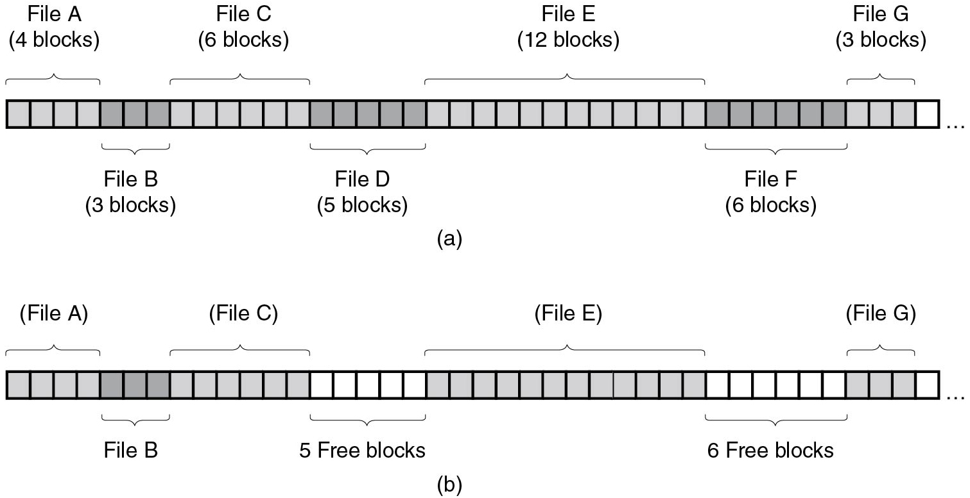
Implementing Files Contiguous Layout
Figure 4.12 (a) Contiguous allocation of disk space for seven files. (b) The state of the disk after files D and F have been removed.
Notes:
Long Description:
Part (a): A horizontal block has 40 partitions. The first four blocks are labeled File A, the next 3 blocks are labeled File B, the next 6 blocks are labeled File C, the next 5 blocks are labeled File D, the next 12 blocks are labeled File E, the next 6 blocks are labeled File F, and the next 3 blocks are labeled File G. Last block is blank and the blocks continue toward the right. Part (b): A horizontal block has 40 partitions. The first four blocks are labeled File A, the next 3 blocks are labeled File B, the next 6 blocks are labeled File C, the next 5 blocks are empty, the next 12 blocks are labeled File E, the next 6 blocks are blank and the next 3 blocks are labeled File G. Last block is blank and the blocks continue toward the right.

Slide 43
How to Store Files on the Disk? (2 of 2)
Contiguous allocation
Store files as a contiguous stream of bytes
Requires max file size, prone to fragmentation
Block-based strategies
Linked List
File Allocation Table
i-nodes

Slide 44
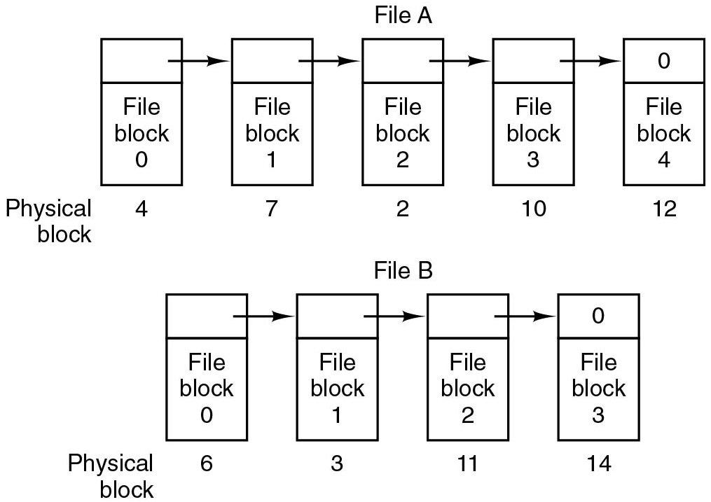
Implementing Files Linked List Allocation
Figure 4.13 Storing a file as a linked list of disk blocks.
Notes:
Long Description:
The image consists of two parts. Part (a): There is a File A with five vertical blocks labeled Physical block with two partitions each. There are forward arrows from the first block to the fifth block. The first block is labeled 4 with the second partition labeled File block 0. The second block is labeled 7 with the second partition labeled File block 1. The third block is labeled 2 with the second partition labeled File block 2. The fourth block is labeled 10 with the second partition labeled File block 3. The fifth block is labeled 12 with the first partition labeled 0 and the second partition labeled File block 4. Part (b): There is a File B with four vertical blocks labeled Physical block with two partitions each. There are forward arrows from the first block to the fifth block. The first block is labeled 6 with the second partition labeled File block 0. The second block is labeled 3 with the second partition labeled File block 1. The third block is labeled 11 with the second partition labeled File block 2. The fourth block is labeled 14 with the first partition labeled 0 and the second partition labeled File block 3.

Slide 45
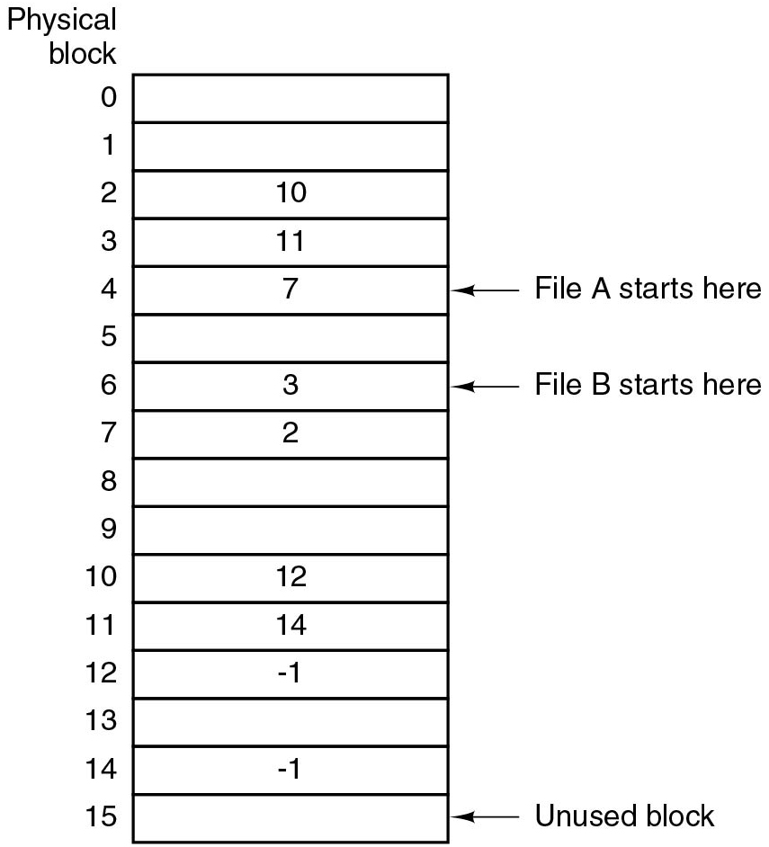
Implementing Files Linked List - Table in Memory
Figure 4.14 Linked list allocation using a file allocation table in main memory.
Notes:
Long Description:
A vertical block labeled physical block has 16 partitions numbered 0 to 15 from top to bottom. Most of the blocks are empty. The blocks that are occupied are as follows: Partition 2 labeled 10, Partition 3 labeled 11, Partition 4 labeled 7 and is categorized as File "A" starts here, Partition 6 labeled 3 and is categorized as File B starts here, Partition 7 labeled 2, Partition 10 labeled 12, Partition 11 labeled 14, Partition 12 labeled negative 1, Partition 14 labeled negative 1. The fifteenth partition is categorized as an Unused block.

Slide 46
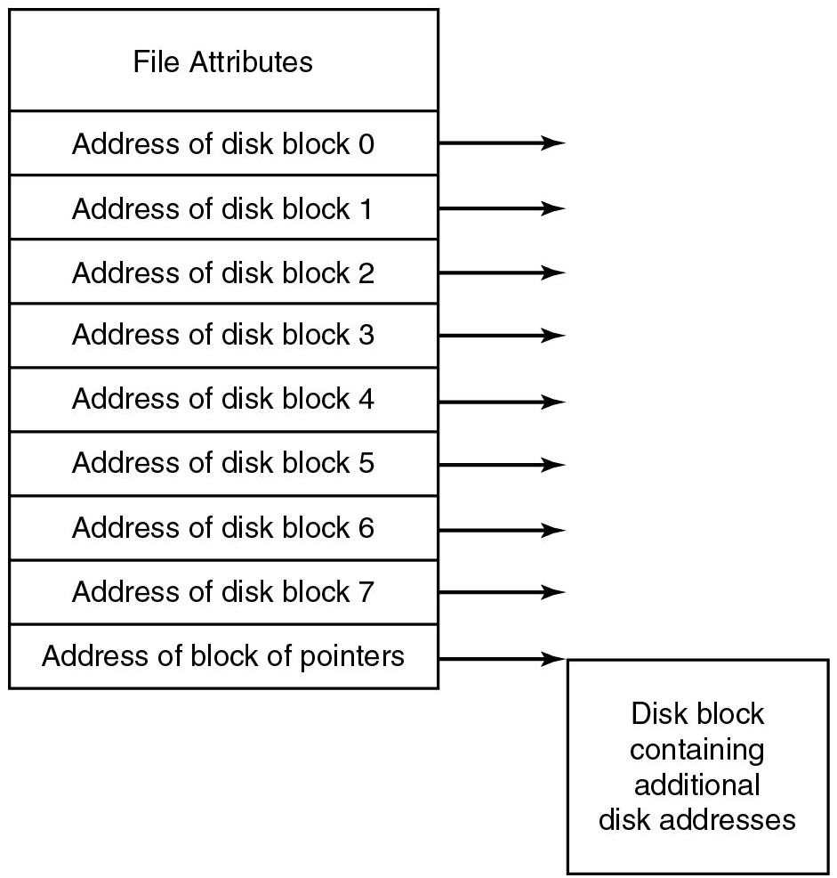
Implementing Files I-nodes
Figure 4.15 An example i-node
Notes:
Long Description:
A vertical block has 10 partitions. An arrow from the right end of all the partitions points to the right. The partitions from top to bottom are as follows: Partition 1 is labeled File Attributes. Partition 2 is labeled Address of disk block 0. Partition 3 is labeled the Address of disk block 1. Partition 4 is labeled the Address of disk block 2. Partition 5 is labeled the Address of disk block 3. Partition 6 is labeled the Address of disk block 4. Partition 7 is labeled the Address of disk block 5. Partition 8 is labeled the Address of disk block 6. Partition 9 is labeled the Address of disk block 7. Partition 10 is labeled the Address of a block of pointers. An arrow from the right end points to a square block labeled Disk block containing additional disk addresses.

Slide 47
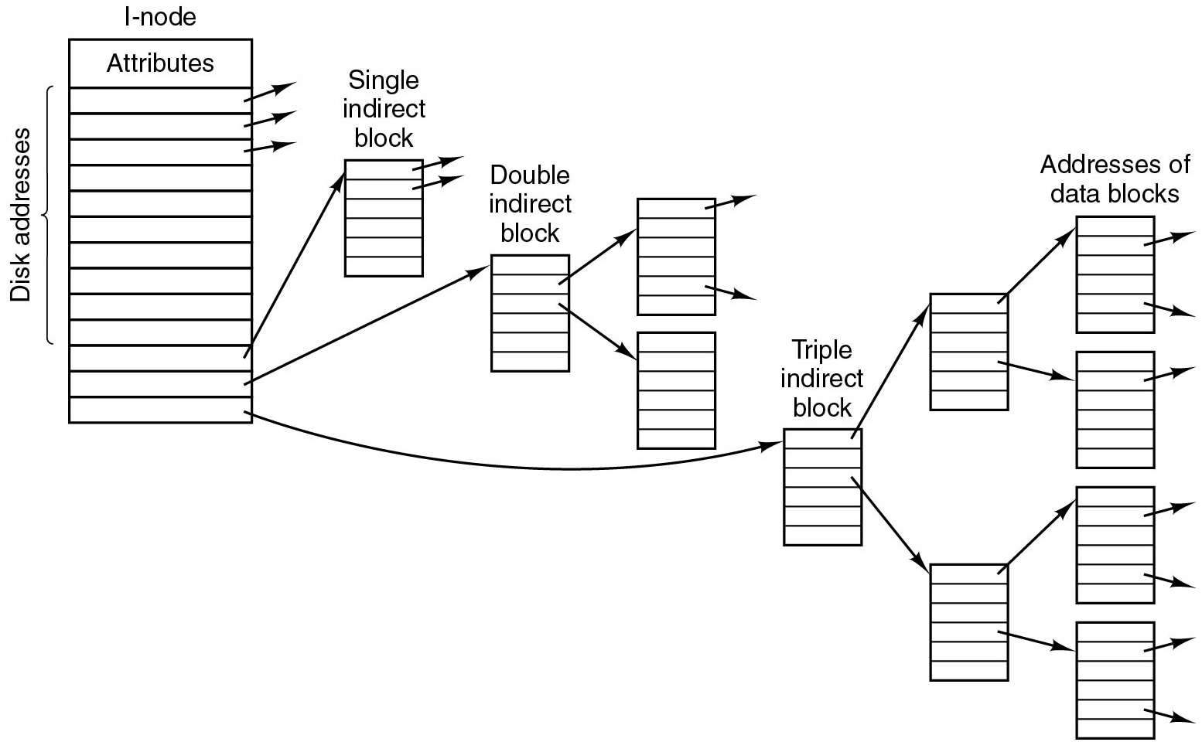
Implementing Files I-nodes with Indirect Blocks
Store list of block addresses per file in an i-node
Better scalability: only require metadata for in-use files
Large-file i-nodes point to indirect blocks with more addresses
Figure 4.35 A U N I X i-node
Notes:
Long Description:
A vertical block labeled I-node has 14 partitions labeled Disk addresses where the first partition is labeled Attribute. The second, third, and fourth partitions have forward arrows. The twelfth partition with an arrow points to the second block labeled Single indirect block with six partitions and the first and second partition has an arrow pointing to the right. The thirteenth partition with an arrow points to the third block labeled Double indirect block with six partitions and the second and third partition has an arrow points to the fourth and fifth block respectively. The fourth block has six partitions and the first and fifth partition has an arrow pointing to the right. The fourteenth partition of the first block has an arrow that points to the sixth block labeled Indirect block with six partitions and the first and third partition has an arrow that points to the seventh and the eighth block. The seventh block has six partitions and the first and fourth partition has an arrow that points to the ninth and tenth block where the ninth block has a second and fifth forward arrow and the tenth block has a second partition that has an arrow pointing to the right. The eighth block has six partitions and the first and fourth partition has an arrow where the first partition points to the eleventh block where the eleventh block has a second and fifth partition that has an arrow and the fourth partition points to the twelfth block where the twelfth block has a second and fifth partition that has an arrow pointing to the right.

Slide 48
File System Implementation (3 of 6)
How to store files?
How to implement directories?
How to manage disk space?
How to ensure file system performance?
How to ensure file system dependability?

Slide 49
Directory Implementation
How to store directory entries and attributes?
How to find the root directory?
How to find any other directory?

Slide 50
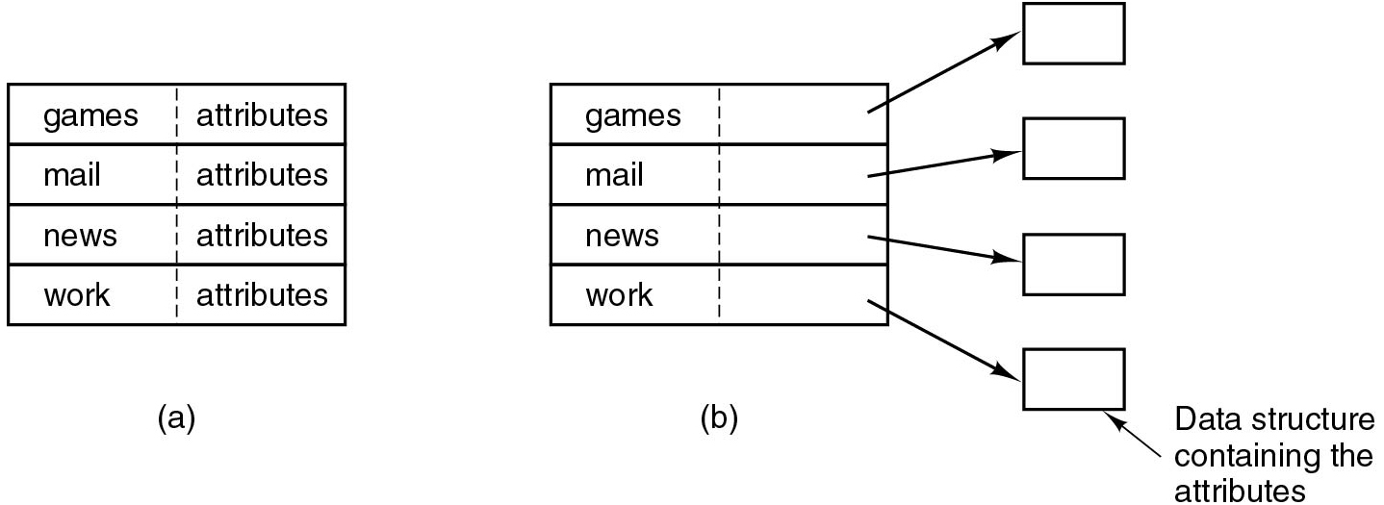
Directory Entries and Attributes
Figure 4.16 (a) A simple directory containing fixed-size entries with the disk addresses and attributes in the directory entry. (b) A directory in which each entry just refers to an i-node.
Notes:
Long Description:
Part (a): A block has two columns and four rows. The row entries are as follows: Row 1: Column 1, games; Column 2, attributes. Row 2: Column 1, mail; Column 2, attributes. Row 3: Column 1, news; Column 2, attributes. Row 4: Column 1, work; Column 2, attributes. Part (b): A block has two columns and four rows. The second column of every row is empty. The first column entries are as follows: Row 1, games; Row 2, mail; Row 3, news; Row 4, work. An arrow from each of the four rows of the second column point to four blocks labeled Data structure containing the attributes.

Slide 51

F A T 12/F A T 16 Layout
Reserved later used for F S information
F A T #1/#2: preallocated File Allocation Tables
Preallocated root directory
Clusters represent addressable blocks:
F A T contains chains indexed by starting cluster
Notes:
Long Description:
The illustration is divided into 6 slots labeled from left to right. Boot sector, reserved, F A T octothorpe 1, F A T octothorpe 2, root directory and clusters.

Slide 52
Quiz (3 of 6)
Why 2 F A T s?

Slide 53
Answer to Quiz (3 of 6)
Q: Why 2 F A T s?
A: F A T-12 came first and F A T-16 was an improvement several years later

Slide 54
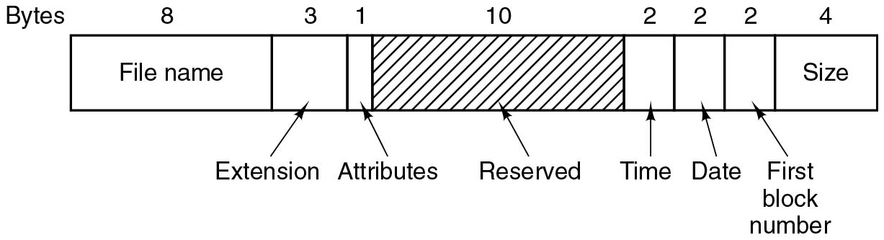
F A T12/16 Directory Entry (1)
Filename in 8.3 format
Later on, Long File Name (L F N) entries used multiple entries for a single file, setting several reserved bits for backwards compatibility
Notes:
Long Description:
A horizontal block has eight partitions. Bytes mentioned above the partitions are labeled 8, 3, 1, 10, 2, 2, 2, and 4. The first partition is labeled Filename, the second partition is labeled Extension, the third partition is labeled Attributes, the fourth partition has diagonal lines and is labeled Reserved, the fifth partition is labeled Time, the sixth partition is labeled Date, the seventh partition is labeled First block number, and the eighth partition is labeled Size.

Slide 55
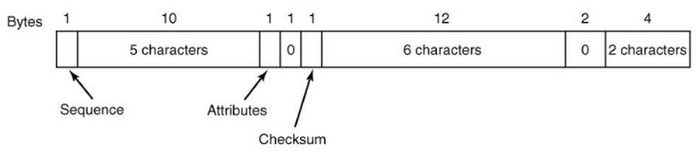
F A T 12/16 Directory Entry (2)
F A T-16 is still widely used in cameras, portable music players, U S B sticks, and other small devices
Notes:
Long Description1:
A horizontal block has eight partitions. Bytes mentioned above the partitions are labeled 8, 3, 1, 10, 2, 2, 2, and 4. The first partition is labeled Filename, the second partition is labeled Extension, the third partition is labeled Attributes, the fourth partition has diagonal lines and is labeled Reserved, the fifth partition is labeled Time, the sixth partition is labeled Date, the seventh partition is labeled First block number, and the eighth partition is labeled Size.
Long Description2:
The illustration is divided into 8 slots labeled from left to right. Sequence, 5 characters, attributes, 0, checksum, 6 characters, 0, and 2 characters. The bytes for the labeled slots are labeled from left to right as follows. 1,10,1,1,1,12,2 and 4.

Slide 56
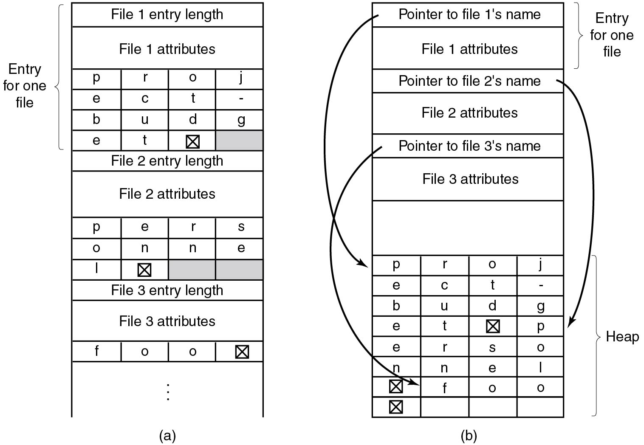
Other Ways to Handle Long File Names
Figure 4.17 Two ways of handling long file names in a directory. (a) In-line. (b) In a heap.
Notes:
Long Description:
Part (a): A vertical block has 9 partitions shown, and more than 9 partitions is depicted by three vertical dots. There are entries of multiple files in this block. The first partition is labeled File 1 entry length. The second partition is labeled File 1 attributes. The third partition is further divided into 4 rows and 4 columns. The row entries are as follows: Row 1: column 1, p; column 2, r; column 3, o; column 4, j. Row 2: column 1, e; column 2, c; column 3, t; column 4, hyphen. Row 3: column 1, e; column 2, t; column 3, square box with a cross inside; column 4, blank and highlighted. The first three partitions are categorized as Entry for one file. The fourth partition is labeled File 2 entry length. The fifth partition is labeled File 2 attributes. The sixth partition is further divided into 3 rows and 4 columns. Row 1: column 1, p; column 2, e; column 3, r; column 4, s. Row 2: column 1, o; column 2, n; column 3, n; column 4, e. Row 3: column 1, l; column 2, square box with a cross inside; Columns 3 and 4: blank and highlighted. The seventh partition is labeled File 3 entry length. The eighth partition is labeled File 3 attributes. The ninth partition is further divided into 4 columns. Row 1: column 1, f; column 2, o; column 3, o; column 4, square box with a cross inside. Part (b): A vertical block has 8 partitions. The first partition is labeled Pointer to file 1's name. The second partition is labeled File 1 attributes. The first two partitions are categorized as Entry for one file. The third partition is labeled Pointer to file 2's name. The fourth partition is labeled File 2 attributes. The fifth partition is labeled Pointer to file 3's name. The sixth partition is labeled File 3 attributes. The seventh partition is blank. The eighth partition has 8 rows and 4 columns and is categorized as Heap. The row entries are as follows: Row 1: column 1, p; column 2, r; column 3, o; column 4, j. Row 2: column 1, e; column 2, c; column 3, t; column 4, hyphen. Row 3: column 1, b; column 2, u; column 3, d; column 4, g. Row 4: column 1, e; column 2, t; column 3, square with a cross inside; column 4, p. Row 5: column 1, e; column 2, r; column 3, s; column 4, o. Row 6: column 1, n; column 2, n; column 3, e; column 4, l. Row 7: column 1, square with a cross inside; column 2, f; column 3, o; column 4, o. Row 8: column 1, square with a cross inside; Columns 2, 3, and 4 are blank.

Slide 57
F A T Partition Size
Block size | F A T-12 | F A T-16 | F A T-32
0.5 K B | 2 M B | Blank | Blank
1 K B | 4 M B | Blank | Blank
2 K B | 8 M B | 128 M B | Blank
4 K B | 16 M B | 256 M B | 1 T B
8 K B | Blank | 512 M B | 2 T B
16 K B | Blank | 1024 M B | 2 T B
32 K B | Blank | 2048 M B | 2 T B
Figure 4.33 Maximum partition size for different block sizes. The empty boxes represent forbidden combinations.

Slide 58
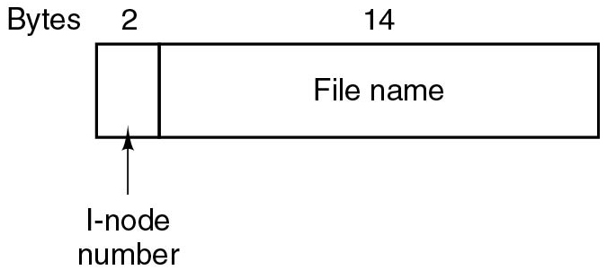
U N I X Directory Entry
Directory entry stores only name and #i-node
Attributes are stored in the i-node
One i-node per file, first i-node is the root
Where are i-nodes stored?
Notes:
Long Description:
A horizontal block has one partition. There are Bytes mentioned above the partitions labeled 2 and 14. The first partition is labeled i-node number and the second partition is labeled File name.

Slide 59
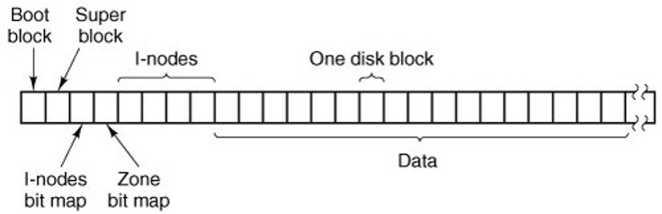
U N I X F S Layout (M I N I X Example)
Notes:
Long Description:
The illustration is divided into 26 slots labeled from left to right as follows. Slot 1 is a boot block, slot 2 is the superblock, slot 3 as I hyphen nodes bit block, slot 4 is a zone bit map, slots 5 to 8 I hyphen nodes, and slots 9 to 25 as data with slot 15 is labeled as one disk block.

Slide 60
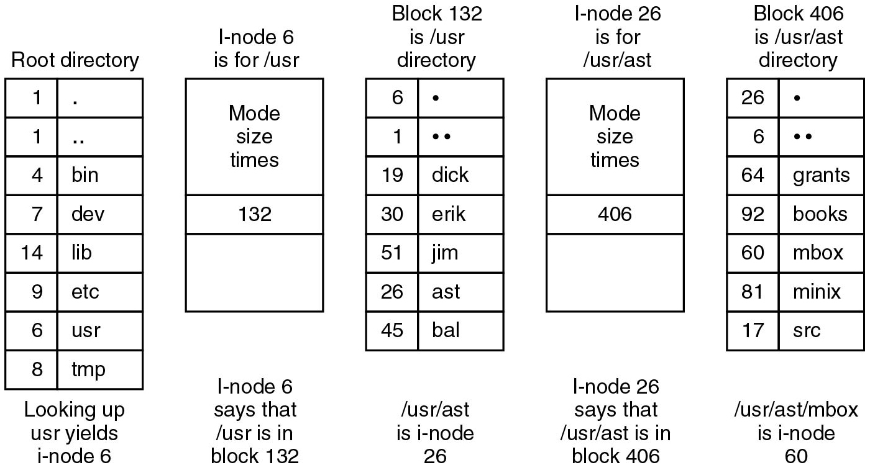
Directory Lookup
Figure 4.36 The steps in looking up /u s r/a s t/mbox.
Notes:
Long Description:
Part (a): There is a vertical block labeled Root directory and has eight rows and two columns. Row 1: column 1, 1; Column 2: dot. Row 2, column 1, 1; column 2, dot. Row 3: column 1, 4; column 2, bin. Row 4: column 1, 7; column 2, dev. Row 5: column 1, 14; column 2, lib. Row 6: column 1, 9; column 2, etc. Row 7: column 1, 6; column 2, u s r. Row 8: column 1, 8; column 2, tmp. Note: Looking up usr yields i-node 6. Part (b): A vertical block labeled i-node 6 is for /usr and has three rows. The first row is labeled Mode size times. The second row is labeled 132. The third row is blank. Note: i-node 6 says that / usr is in block 132. Part (c): A vertical block labeled Block 132 is /usr directory and has seven rows and two columns. Row 1: column 1, 6; Column 2, dot. Row 2: column 1, 1; column 2, dot. Row 3: column 1, 19; column 2, dick. Row 4: column 1, 30; column 2, Erik. Row 5: column 1, 51; column 2, Jim. Row 6: column 1, 26; column 2, ast. Row 7: column 1, 45; column 2, bal. Note: /usr/ast is i-node 26. Part (d): Note: i-node 26 is for /usr/ast and has three rows. The first row is labeled Mode size times. The second row is labeled 406. The third row is blank. Note: i-node 6 that says that /usr/ast is in block 406. Part (e): There is a vertical block labeled Block 406 is /usr/ast directory and has seven rows and two columns. Row 1: column 1, 26; Column 2, dot. Row 2: column 1, 6; column 2, dot. Row 3: column 1, 64; column 2, grants. Row 4: column 1, 92; column 2, books. Row 5: column 1, 60; column 2, mbox. Row 6: column 1, 81; column 2, minix. Row 7: column 1, 17; column 2, src. Note: /usr/ast/mbox is i-node 60.

Slide 61
Quiz 1
How many disk accesses for reading first byte from /usr/ast/mbox?

Slide 62
Answer to Quiz 1
How many disk accesses for reading first byte from /usr/ast/mbox?
7 (3 directories, 3 i-nodes, 1 file data)

Slide 63
Quiz 2
How many disk accesses for reading first byte from /usr/ast/mbox?
7 (3 directories, 3 i-nodes, 1 file data)
How many on F A T?

Slide 64
Answer to Quiz 2
How many disk accesses for reading first byte from /usr/ast/mbox?
7 (3 directories, 3 i-nodes, 1 file data)
How many on F A T?
4 (3 directories, 1 file data)

Slide 65
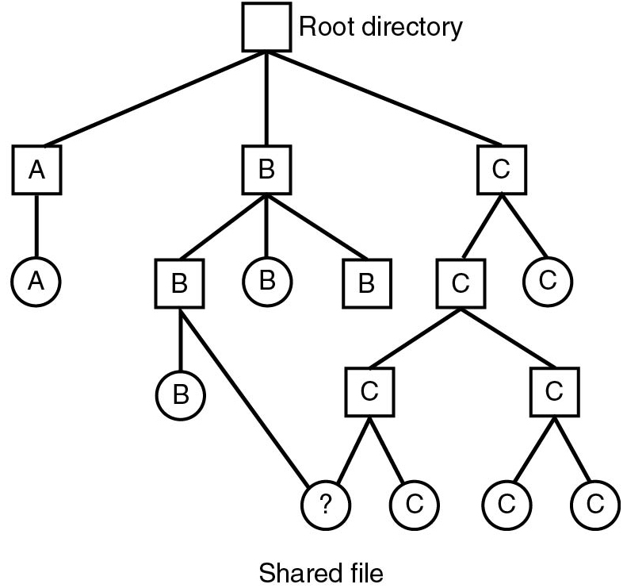
Shared Files (1)
Figure 4.18 File system containing a shared file.
Notes:
Long Description:
A tree that starts with a square box labeled Root directory. Level 1: The Root directory has three possibilities in square boxes labeled A, B, and C from left to right. Level 2: A has a possibility labeled A in the circle. B has three possibilities labeled B, B, and B from left to right. The left and right possibilities are in square boxes whereas the center is in a circle. C has two possibilities, a square box on the left labeled C and right in the circle is labeled C. Level 3: Level 2 B possibility has three possibilities B in a square box on left, B in a circle on center, and B on right in a square box. Level 2 C possibility has two possibilities C on left in a square box and C on right in the circle. Level 4: Level 3 both C possibility on left has two further possibilities question mark and C in the circle. The level 4 question mark possibility is connected to level 2 B possibility on left and labeled Shared file. Level 3 both C possibilities on right have two further possibilities C and C in the circle.

Slide 66
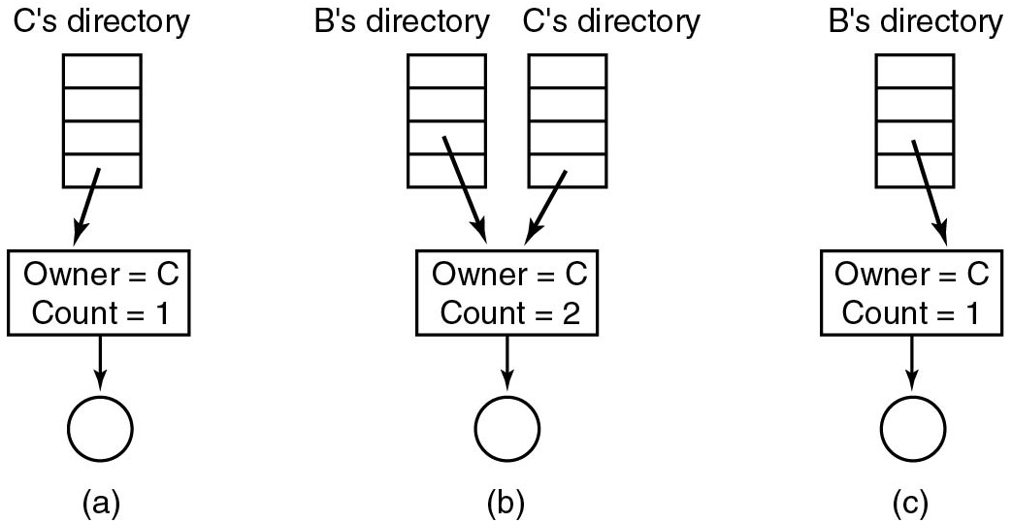
Shared Files (2)
Figure 4.19 (a) Situation prior to linking. (b) After the link is created. (c) After the original owner removes the file.
Notes:
Long Description:
Part (a): A vertical block labeled C's directory has four partitions. The fourth partition has a downward arrow that points to block labeled Owner equals C, Count equals 1. The block with a downward arrow further points to the circle. Part (b): There are two vertical blocks labeled B's directory and C's directory with four partitions. The third and fourth partition of both blocks with two downward arrows points to block labeled Owner equals C, Count equals 2. The block with a downward arrow further points to the circle. Part (c): There is a vertical block labeled B's directory with four partitions. The third partition of a block with a downward arrow points to block labeled Owner equals C, Count equals 1. The block with a downward arrow further points to the circle.

Slide 67
Hard Links versus. Soft Links
Hard links reference a shared file (i-node)
The file is removed only with no hard links left
Space-efficient (only 1 directory entry per hard link)
Good to manage shared files across owners
Soft (or symbolic) links reference a file name
Removing the file renders its soft links invalid
Less space-efficient (need 1 i-node per soft link)
More flexible (can reference file names across F Ses)

Slide 68
File System Implementation (4 of 6)
How to store files?
How to implement directories?
How to manage disk space?
How to ensure file system performance?
How to ensure file system dependability?

Slide 69
Block Size
How do choose the block size?
Important speed-space tradeoff to consider
Larger block sizes allow transferring more data per block
Better overall data rates
Smaller block sizes reduce space overhead for small files
Less fragmentation

Slide 70
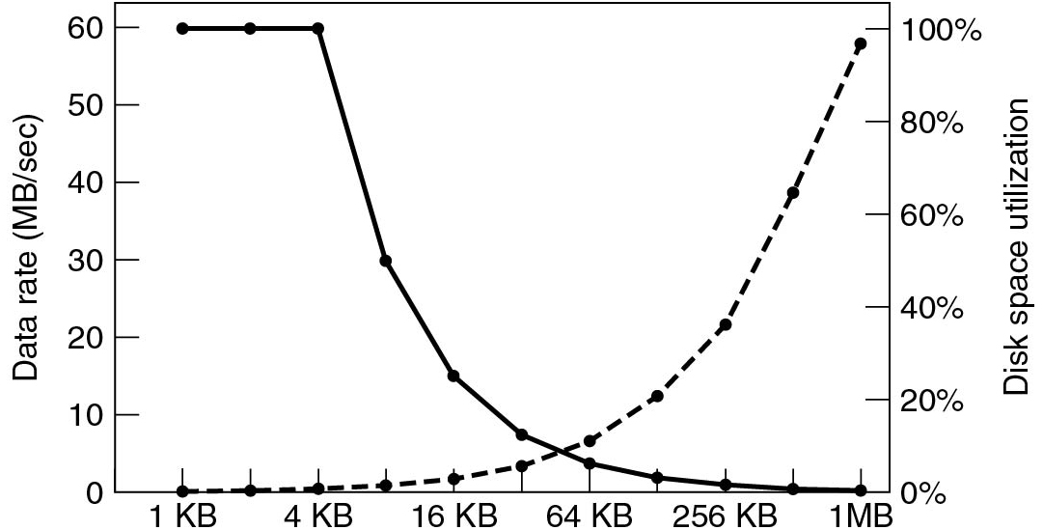
Block Size Impact
Figure 4.23 The dashed curve (left-hand scale) gives the data rate of a disk. The solid curve (right-hand scale) gives the disk space efficiency. All files are 4 K B.
Notes:
Long Description:
The horizontal axis has the following marks: 1 K B, 4 K B, 16 K B, 64 K B, 256 K B, AND 1 M B. The left vertical axis is labeled Data Rate (M B per second) and ranges from 0 to 60 in increments of 10 units. The right vertical axis is labeled Disk space utilization and ranges from 0 percent to 100 percent in increments of 20 units. The first dotted curve starts from (1 K B, 0), moves linearly to the point (12 K B, 0), then raises upward like a concave upward, and increases linearly until the point (1 M B, 60) on the left axis and (1 M B, 100 percent) on the right axis. The curve passes through the following points: (16 K B, 1), (64 K B, 10), and (256 K B, 25). The second curve starts from point (1 K B, 80) moves horizontally until the point (12 K B, 60), then falls as a concave up curve, and ends at the point (1 MB, 0) on the left axis and (1 M B, 0 percent) on the right axis. The curve passes through the following points: (16 K B, 15), (64 K B, 5), and (256 K B, 1).

Slide 71
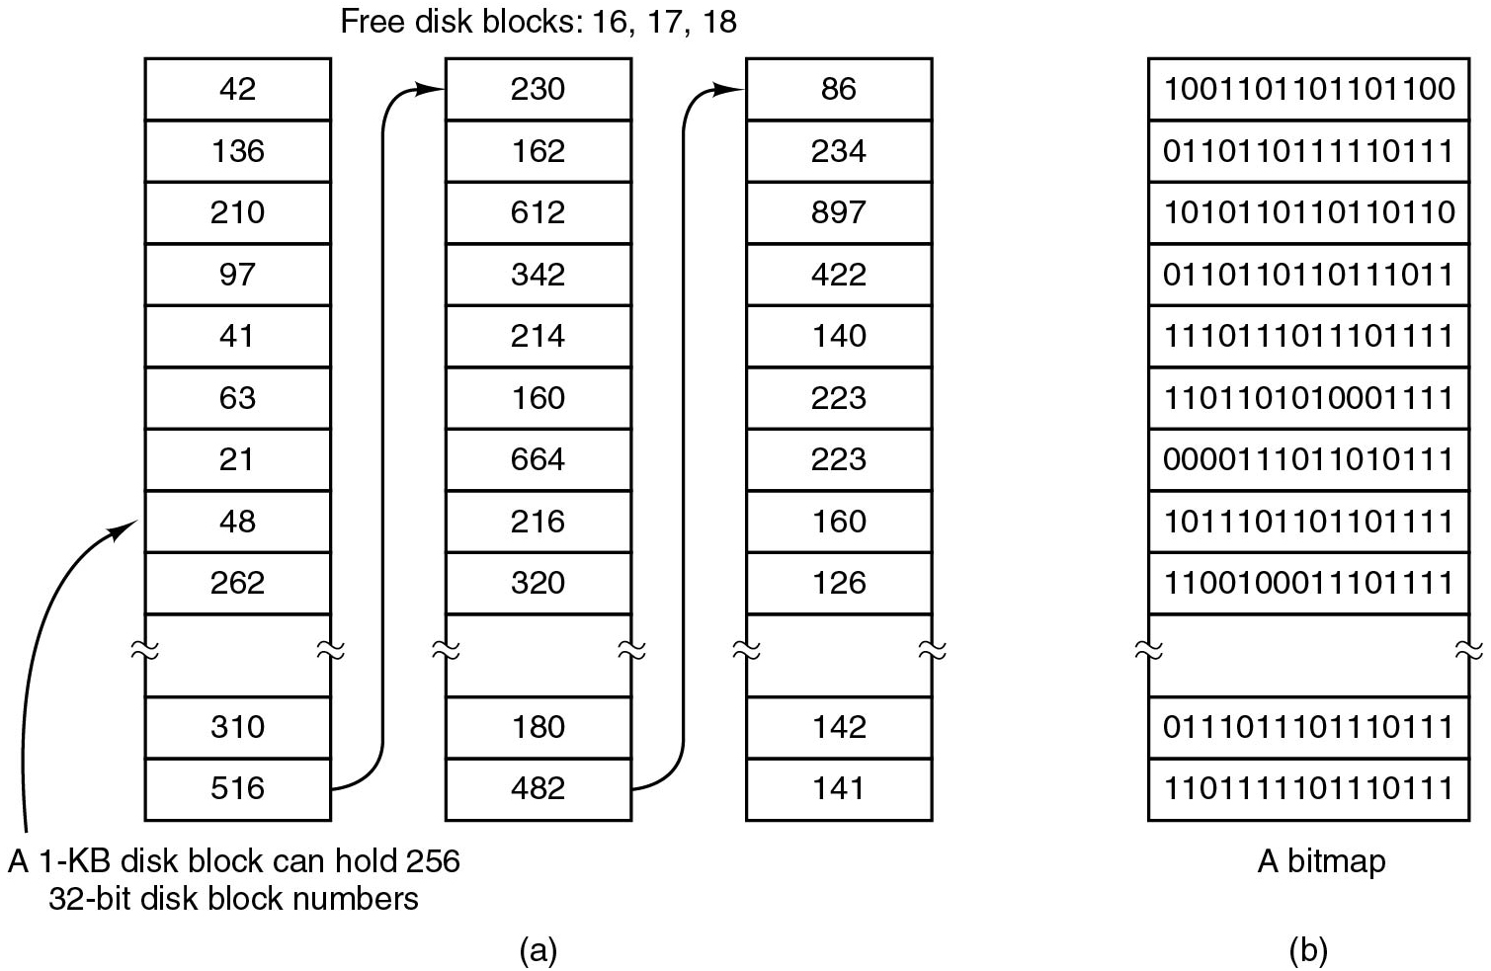
Keeping Track of Free Blocks (1)
Figure 4.24 (a) Storing the free list on a linked list. (b) A bitmap.
Notes:
Long Description:
Part (a): Three vertical blocks are labeled Free disk blocks 16, 17, 18. The first vertical block has 12 partitions from top to bottom labeled 42, 136, 210, 97, 41, 63, 21, 48, 262, blank block, 310, and 516. An arrow labeled A 1 K B disk blocks can hold 256, 32-bit disk block numbers points to the partition labeled 48. An arrow from the partition labeled 516 points to the second block's first partition labeled 230. There are twelve partitions in the second block and the partitions are labeled 230, 162, 612, 312, 214, 160, 664, 216, 320, blank block, 180, and 482. An arrow from partition labeled 482 points to the third block's first partition labeled 86. There are twelve partitions of the third block and the partitions are labeled 86, 234, 897, 422, 140, 223, 223, 160, 126, blank block, 142, and 141. Part (b): There is a vertical block labeled A bitmap and has twelve partitions and from the bottom eleventh block is empty. Entries of each partition are as follows: First partition, 1001101101101100. Second partition, 0110110111110111. Third partition, 1010110110110110. Fourth partition, 0110110110111011. Fifth partition, 1110111011101111. Sixth partition, 1101101010001111. Seventh partition, 0000111011010111. Eighth partition, 1011101101101111. Nineth partition, 1100100011101111. Tenth partition, blank. Eleventh partition, 0111011101110111. Twelfth partition, 1101111101110111.

Slide 72
Quiz (4 of 6)
Which organization incurs more space overhead?
Hint: consider an almost empty disk scenario and an almost full disk scenario.

Slide 73
Answer to Quiz (4 of 6)
Q: Which organization incurs more space overhead?
A: On an empty disk, every block will be on the free list so it will be very big. On an almost full disk, it will be tiny. The bit map is a fixed size and independent of how full the disk is.

Slide 74
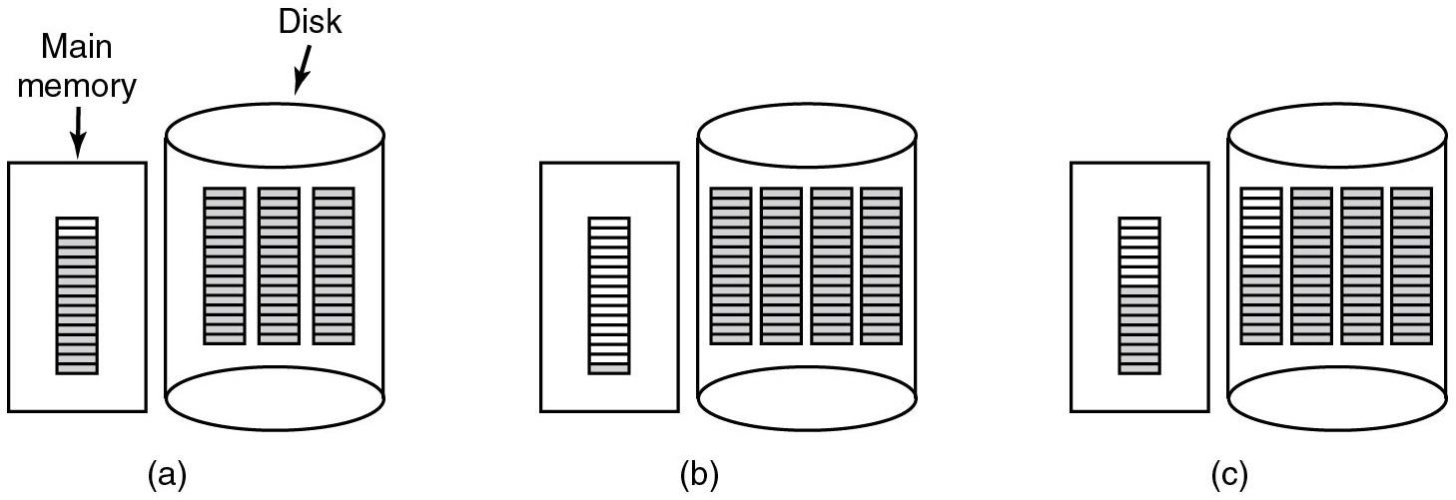
Keeping Track of Free Blocks (2)
Figure 4.25 (a) An almost-full block of pointers to free disk blocks in memory and three blocks of pointers on disk. (b) Result of freeing a three-block file. (c) An alternative strategy for handling the three free blocks. The shaded entries represent pointers to free disk blocks.
Notes:
Long Description:
In all three parts, there is a rectangular block labeled Main memory, and a cylinder labeled Disk. Part (a): One rectangular block with several partitions is placed in the rectangular block. Three rectangular blocks with several partitions are placed in the cylindrical block. Part (b): One rectangular block with several partitions is placed in the rectangular block. Four rectangular blocks with several partitions are placed in the cylindrical block. Part (c): One rectangular block with several partitions is placed in the rectangular block. Four rectangular blocks with several partitions are placed in the cylindrical block. The shaded entries represent pointers to free disk blocks.

Slide 75
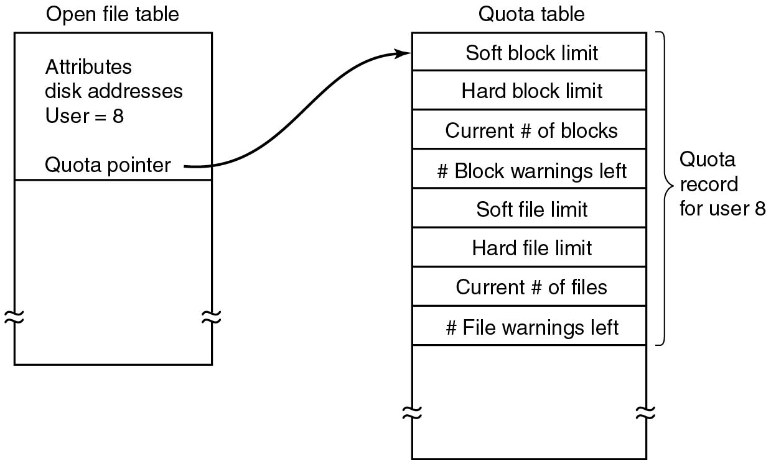
Disk Quotas
Figure 4.26 Quotas are kept track of on a per-user basis in a quota table.
Notes:
Long Description:
A vertical block labeled Open file table has one partition. The first partition is labeled Attributes disk addresses User equals 8, Quota Pointer. An arrow from the Quota pointer points to another vertical block labeled Quota table having 9 partitions. The first eight partitions are categorized as Quota records for user 8. The partitions are labeled from top to bottom as follows: Soft block limit, Hart block limit, Current hash of blocks, hash Block warnings left, Soft file limit, Current has of files, and hash File warnings left. The last partition is blank.

Slide 76
File System Implementation (5 of 6)
How to store files?
How to implement directories?
How to manage disk space?
How to ensure file system performance?
How to ensure file system dependability?

Slide 77
File System Performance
How to optimize file system performance?
Minimize disk access
Minimize seek time
Minimize space usage

Slide 78
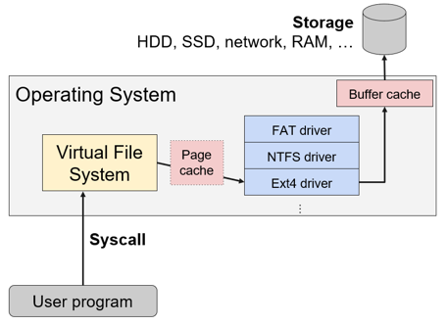
Minimize Disk Access: Caching
Buffer cache: Cache disk blocks in R A M
Page cache: Cache V F S pages (before going to driver)
Often same data as buffer cache, so O S may merge them
Notes:
Long Description:
The flow chart labeled from bottom to top is as follows. User program; syscall of open, read, write, readdir, ellipsis; virtual file system; page cache, F A T driver, N T F S driver and E x t 4 driver; buffer cache; storage of H D D, S S D, network, R A M, ellipsis. The virtual file system, page cache, F A T driver, N T F S driver and E x t 4 driver, and buffer cache are part of the operating system.

Slide 79
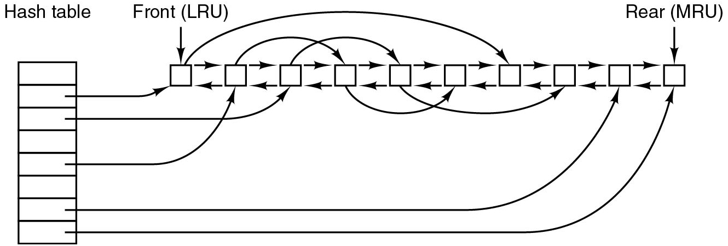
Cache Management
Caches have L R U semantics adapted to:
Blocks with poor temporal locality
Critical blocks for file system consistency
Write-through caching versus. periodic syncing
Disk read-ahead: read blocks that may be used soon
Notes:
Long Description:
A vertical block labeled Hash table has eight partitions. There is a chain of 10 nodes with arrows so that all nodes are connected except the first and last node. The first node is labeled Front (L R U) and the last node is labeled Rear (MRU). An arrow from the second partition of the Hash table points to the first node. An arrow from the third partition of the Hash table points to the third node. An arrow from the fifth partition of the Hash table points to the second node. An arrow from the seventh partition of the Hash table points to the ninth node. An arrow from the eighth partition of the Hash table points to the tenth node. An arrow from the first node in the queue points to the seventh node. An arrow from the second node in the queue points to the fourth node. An arrow from the third node in the queue points to the fifth node. An arrow from the fourth node in the queue points to the sixth node. An arrow from the fifth node in the queue points to the eighth node.

Slide 80
Quiz (5 of 6)
Why is yanking out a U S B stick considered “unsafe”?

Slide 81
Answer to Quiz (5 of 6)
Q: Why is yanking out a U S B stick considered “unsafe”?
A: Because there could be ”dirty” blocks in the cache that won’t be written back to the stick, losing their information

Slide 82
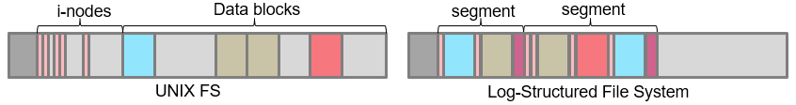
Minimize Disk Access: Log-structure File Systems
Idea: Optimize for frequent small writes
Collect pending writes in a log segment with i-nodes, entries, blocks
Segments are often flushed to disk and can be large (e.g., 1 M B)
i-node map to find i-nodes in the log
Garbage collection to reclaim old log entries
Notes:
Long Description:
The left side of the illustration is a rectangular figure with slots labeled as U N I X F S. There are 16 slots with slots 1 to 9 labeled as i hyphen node and 9 to 16 labeled as data blocks. The right side of the illustration is a rectangular figure with slots labeled as log hyphen structured file system. The figure has 15 slots with slots 1 to 6 labeled as segment and 6 to 15 labeled as segment.

Slide 83
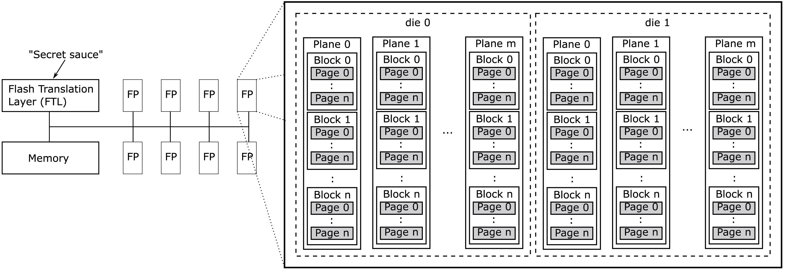
Similar Techniques Used in Flash-Based File Systems
Figure 4.20 Components inside a typical flash S S D.
Notes:
Long Description:
Part (a): The first horizontal block labeled Flash Translation Layer (F T L). An arrow labeled "Secret sauce" on top of the block. This block is connected with a vertical line to a second block labeled Memory placed at bottom of the first block. There are eight blocks labeled F P placed four at the top and parallel to the first block. The other four blocks are placed at the bottom and parallel to the second block. A horizontal line from the vertical line with all eight blocks is connected. Part (b): A large rectangular block has two dotted rectangular blocks labeled die 0 and die 1 inside it. There are m vertical blocks labeled plane 0, plane 1, and up to plane m inside both blocks, arranged side by side. In every vertical block, there are several blocks labeled block 0, block 1, and up to block n corresponding to pages labeled Page 0 to page n in every block.

Slide 84
Minimize Seek Time: H D D Layout Management
Not an issue for modern S S D s
“Seek time” is constant
Important for traditional H D D s
Different strategies to minimize H D D seek time:
Try to allocate files contiguously
Defragment disk
Store small file data “inline” in i-node
Spread i-nodes over the disk rather than at the start

Slide 85
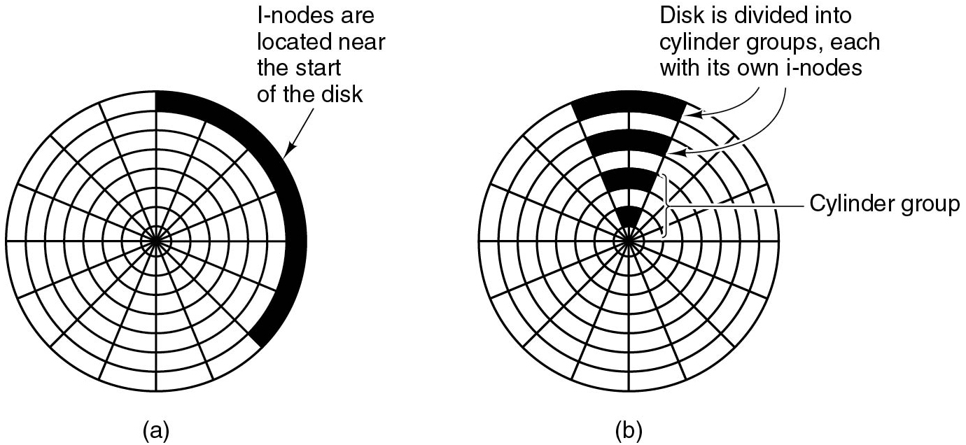
Spread i-nodes Over the Disk
Figure 4.31 (a) I-nodes placed at the start of the disk. (b) Disk divided into cylinder groups, each with its own blocks and i-nodes.
Notes:
Long Description:
Part (a): Seven concentric rings and 15 diagonal lines divide a circle into different parts. The first outer ring is shaded up to six parts and labeled I-nodes are located near the start of the disk. Part (b): There are seven concentric rings in a circle and there are 15 diagonal lines in a circle. The first outer ring and alternate rings are shaded up to two parts and labeled Disk is divided into cylinder groups, each with its own i-nodes. These alternate rings are categorized as the Cylinder group.

Slide 86
Minimize Space Usage: Compression and Deduplication
Compression: simplest method to use scarce storage more efficiently
Can use a files system that compresses automatically
N T F S (Windows), Brtfs (Linux), Z F S (various)
Can remove redundancy at file level or across files
Deduplication: eliminate duplicate file copies
File level, portions of files, individual disk blocks
Inline using hashing
Or asynchronously in the background

Slide 87
File System Implementation (6 of 6)
How to store files?
How to implement directories?
How to manage disk space?
How to ensure file system performance?
How to ensure file system dependability?

Slide 88
File System Dependability Threats
Disk failures:
Bad blocks
Whole-disk errors
Power failures:
(Meta)-data inconsistently written to disk
Software bugs:
Bad (meta)-data written to disk
User errors:
Lost or stolen computer

Slide 89
File System Backups
Backups to disk are generally made to handle one of two potential problems:
Recover from disaster.
Recover from stupidity.

Slide 90
Backups: Properties
Incremental versus. full
Online versus. offline
Physical versus. logical
Compressed versus. uncompressed
Local versus. remote

Slide 91
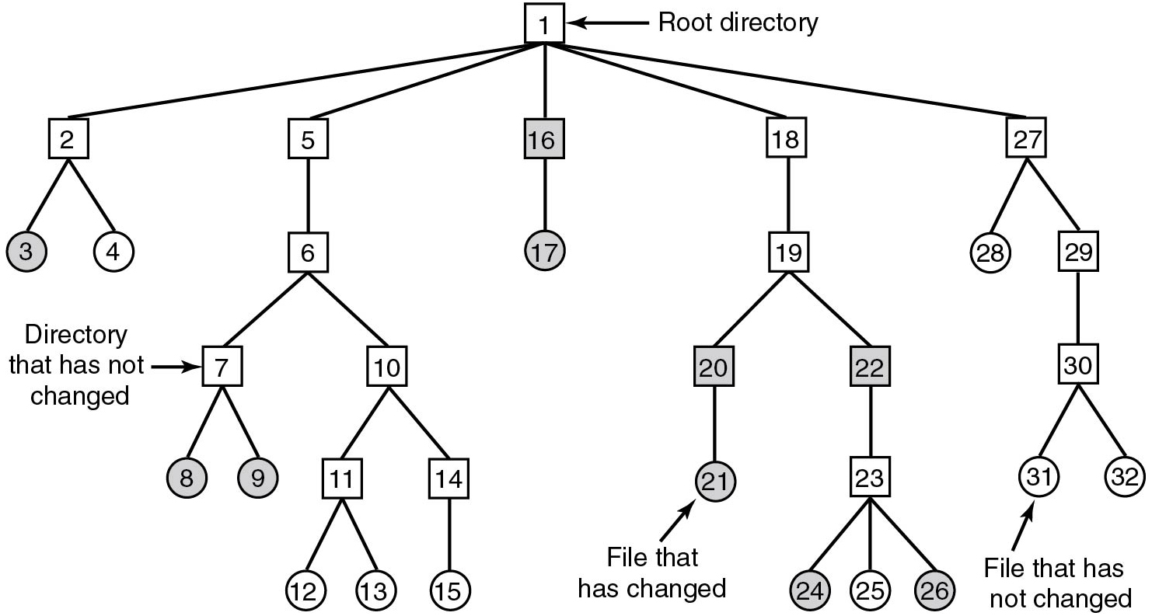
Incremental Logical Backup (1)
Figure 4.27 A file system to be dumped. The squares are directories and the circles are files. The shaded items have been modified since the last dump. Each directory and file is labeled by its i-node number.
Notes:
Long Description:
A tree starts with a Root directory labeled 1. Root directory has five possibilities 2, 5, 16, 18, and 27. Possibility 16 is highlighted. Possibility 2 has two possibilities 3 and 4. Possibility 5 has one possibility 6. Possibility 16 has one possibility 17 and is highlighted. Possibility 18 has one possibility 19. Possibility 27 has two possibilities 28 and 29. Possibility 6 has two possibilities 7 and 10 and is labeled a Directory that has not changed. Possibility 27 has two possibilities 28 and 29. Possibility 19 has two possibilities 20 and 22. Possibility 29 has one possibility 30. Possibility 7 has two possibilities 8 and 9 and highlighted. Possibility 10 has two possibilities 11 and 14. Possibility 20 has one possibility 21, highlighted and labeled a File that has changed. Possibility 22 has one possibility 23. Possibility 30 has two possibilities 31 and 32 and is labeled a File that has not changed. Possibility 11 has two possibilities 12 and 13. Possibility 14 has one possibility 15. Possibility 23 has two possibilities 24, 25, and 26, and 24, 26 are highlighted. All leaf nodes are represented in circles and other nodes are represented in squares.

Slide 92
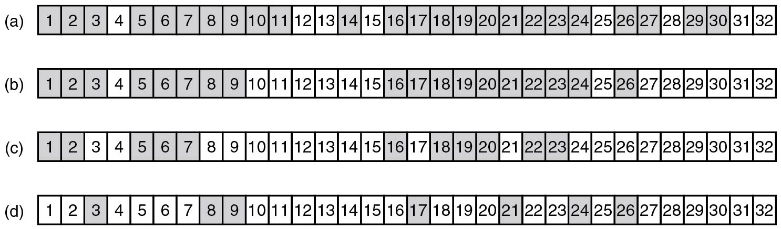
Incremental Logical Backup (2)
Figure 4.28 Bitmaps used by the logical dumping algorithm.
Notes:
Long Description:
Part (a): A horizontal block has 32 partitions and the partitions are labeled from 1 to 32. The partitions numbered 4, 12, 13, 15, 25, 28, 31, and 32 are not highlighted, and all other partitions are highlighted. Part (b): A horizontal block has 32 partitions and the partitions are labeled from 1 to 32. The partitions numbered 4, 10, 11, 12, 13, 14, 15, 25, 27, 28, 29, 30, 31, and 32 are not highlighted, and all other partitions are highlighted. Part (c): A horizontal block has 32 partitions and the partitions are labeled from 1 to 32. The partitions numbered 3, 4, 8, 9, 10, 11, 12, 13, 14, 15, 17, 21, 24, 25, 26, 27, 28, 29, 30, 31, and 32 are not highlighted, and all other partitions are highlighted. Part (d): A horizontal block has 32 partitions and the partitions are labeled from 1 to 32. The partitions numbered 1, 2, 4, 5, 6, 7, 10, 11, 12, 13, 14, 15, 16, 18, 19, 20, 22, 23, 25, 27, 28, 29, 30, 31, and 32 are not highlighted, and all other partitions are highlighted.

Slide 93
Stable Storage (1)
Uses pair of identical disks
Either can be read to get same results
Operations defined to this end:
Stable Writes
Stable Reads
Crash recovery

Slide 94
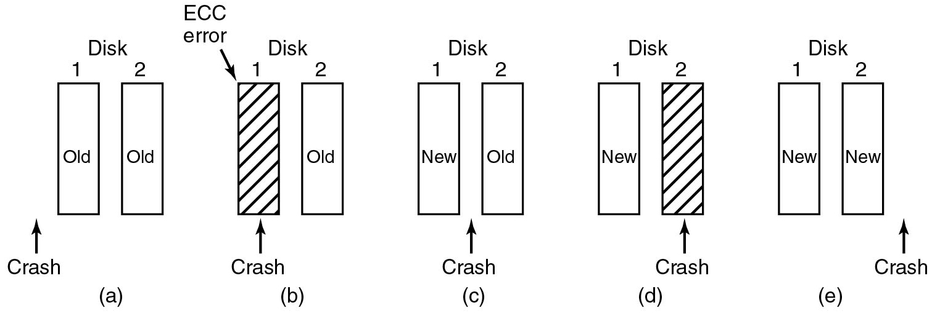
Stable Storage (2)
Figure 5.25 Analysis of the influence of crashes on stable writes.
Notes:
Long Description:
Each figure consists of two sets of vertical blocks labeled disk. Each block is marked 1 and 2 respectively.
Figure a: Here the first and second block is labeled old. An arrow labeled crash is placed to the left of block 1 which points upward.
Figure b: Here the second block is labeled old, and the first block is shaded and labeled E C C error. An arrow labeled crash is placed below block 1 which points upward.
Figure c: Here the first and second block is labeled new and old respectively. An arrow labeled crash is placed between the two blocks and points upward.
Figure d: Here the first block is labeled new. The second block is shaded. An arrow labeled crash is placed below block 2 which points upward.
Figure e: Here the first and second block is labeled new. An arrow labeled crash is placed to the right of block 2 which points upward.

Slide 95
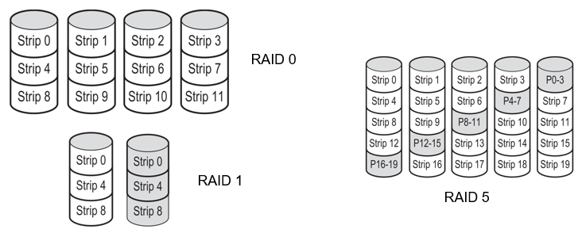
RAID: Redundant Array of Independent Disks
RAID 0 & 2: Expand file system over multiple disks (+storage)
RAID 1: Duplicate file system over disks (+redundancy)
RAID 3-6: Store parity information (+storage, +redundancy)
Notes:
Long Description:
The first illustration labeled as R A I D 0 consists of 4 stacks of 3 cylinders in each. The cylinders in each stack from left to right are labeled as follows. Strip 0, strip 4, strip 8; strip 1, strip 5, strip 9; strip 2, strip 6, strip 10; strip 3, strip 7, strip 11. The second illustration labeled as R A I D 1 consists of 2 stacks of 3 cylinders in each. The cylinders in each stack from left to right are labeled as follows. Strip 0, strip 4, strip 8; strip 0, strip 4, strip 8. The third illustration labeled as R A I D 5 consists of 5 stacks of 5 cylinders in each. The cylinders in each stack from left to right are labeled as follows. Strip 0, strip 4, strip 8, strip 12, strip, P 16 hyphen 19; strip 1, strip 5, strip 9, P 12 hyphen 15, strip 16; strip 2, strip 6, P 8 hyphen 11, strip 13, strip 17; strip 3, P 4 hyphen 7, strip 10, strip 14, strip 18; P 0 hyphen 3, strip 7, strip 11, strip 15, strip 19.

Slide 96
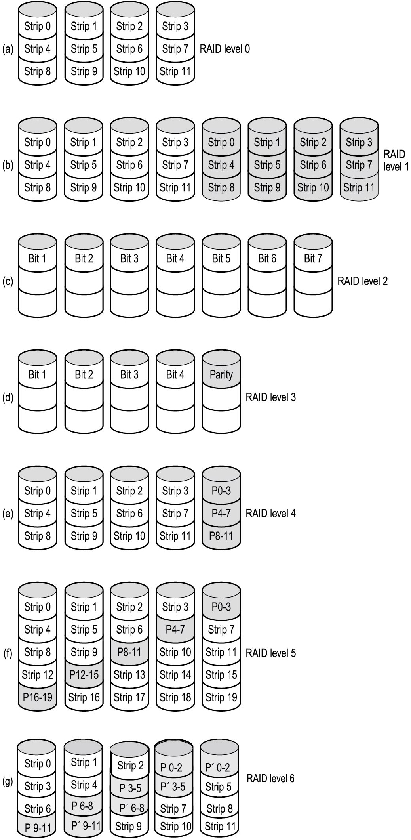
R A I D (1)
Figure 5.26 R A I D levels 0 through 3. Backup and parity drives are shown shaded.
Notes:
Long Description:
Figure a: R A I D level 0: It contains a set of four cylinders which is divided into three sections. The upper sections of each are labeled strip 0, strip 1, strip 2, and strip 3. The middle sections are labeled strip 4, strip 5, strip 6, and strip 7. The lower sections are labeled strip 8, strip 9, strip 10, and strip 11.
Figure b: R A I D level 1: It contains two sets of four cylinders which are divided into three sections. Each set is labeled similarly to the previous figure. The second set of cylinders is shaded.
Figure c: R A I D level 2: It contains a set of seven cylinders which are divided into three sections. The upper sections of each are labeled Bit 1, Bit 2, Bit 3, Bit 4, Bit 5, Bit 6, and Bit 7.
Figure d: R A I D level 3: It contains a set of five cylinders which are divided into three sections. The upper sections of each are labeled Bit 1, Bit 2, Bit 3, Bit 4, Bit 5.

Slide 97
R A I D (2)
Figure 5.26 R A I D levels 4 through 6. Backup and parity drives are shown shaded.
Notes:
Long Description:
Figure e: RAID level 4: It contains a set of five cylinders which are divided into three sections. For the first four cylinders: The upper sections of each cylinder are labeled strip 0, strip 1, strip 2, and strip 3. The middle sections are labeled strip 4, strip 5, strip 6, and strip 7. The lower sections are labeled strip 8, strip 9, strip 10, strip 11.
For the fifth cylinder: The sections are labeled P O 3, P O 7, P 8 to 11 from top to bottom.
Figure f: RAID level 5: It contains a set of five cylinders which are divided into five sections. The sections of each cylinder are labeled in the following way. Section 1: strip 0, strip 1, strip 2, strip 3, P 0 to 3. Section 2: strip 4, strip 5, strip 6, P 4 to 7, strip 7. Section 3: strip 6, strip 9, P 8 to 11, strip 10, strip 11. Section 4: strip 12, P 12 to 15, strip 13, strip 14, strip 15. Section 5: P 16 to 19, strip 16, strip 17, strip 18, strip 19.
Figure g: RAID level 6: It contains a set of five cylinders which are divided into five sections. The sections of each cylinder are labeled in the following way. Section 1: strip 0, strip 1, strip 2, P 0 to 2, P prime 0 to 2. Section 2: strip 3, strip 4, P 3 to 5, P prime 3 to 5. Section 3: strip 6, P 6 to 8, P prime 6 to 8, strip 7, strip 8. Section 4: strip 12, P 12 to 15, strip 13, strip 14, strip 15. Section 5: P 9 to 11, P prime 9 to 11, strip 9, strip 10, strip 11.

Slide 98
Quiz (6 of 6)
Does RAID help with the following threats:
Physical failure (disk stops working)?
Computer catching fire or getting stolen?
Power failure (inconsistent write)?
Bug in driver?
User error?

Slide 99
Answers to Quiz (6 of 6)
Does RAID help with the following threats:
Physical failure (disk stops working)? Yes
Computer catching fire or getting stolen? No
Power failure (inconsistent write)? Yes
Bug in driver? Maybe, depends on the bug
User error? No

Slide 100
File System Consistency Check
Programs like fsck and chkdsk try to find (and fix) consistency errors in file system metadata, including:
Corrupt values
Used blocks also marked as free
Blocks not marked as free nor used
Blocks being used multiple times

Slide 101
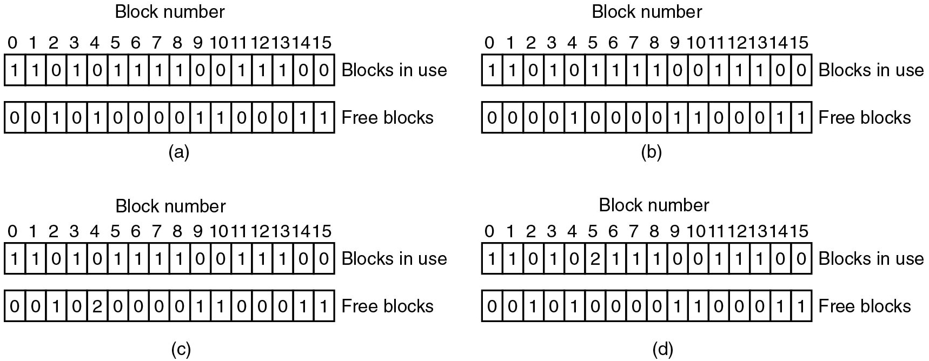
File System Consistency
Figure 4.29 File system states. (a) Consistent. (b) Missing block. (c) Duplicate block in free list. (d) Duplicate data block.
Notes:
Long Description:
All four parts are labeled Block number have two horizontal blocks placed one above the other. The first block labeled Blocks in use has 16 partitions numbered 0 to 15. The entries of the blocks are: 1 1 0 1 0 1 1 1 1 0 0 1 1 1 0 0. Part (a): The entries of the second block are: 0 0 1 0 1 0 0 0 0 1 1 0 0 0 1 1. Part (b): The entries of the second block are: 0 0 0 0 1 0 0 0 0 1 1 0 0 0 1 1. Part (c): The entries of the second block are: 0 0 1 0 2 0 0 0 0 1 1 0 0 0 1 1. Part (d): The entries of the second block are: 0 0 1 0 1 0 0 0 0 1 1 0 0 0 1 1.

Slide 102
Journaling File Systems
Idea: Use “logs” for crash recovery
First write transactional operations in log
E.g., removing a file:
Remove file from its directory
Release i-node to the pool of free i-nodes
Return all disk blocks to pool of free blocks
After crash, replay operations from log
Single operations need to be idempotent
Should support multiple, arbitrary crashes
Journaling widely used in modern F S es (e.g., Ext4, N T F S)

Slide 103
Secure File Detection and Disk Encryption
Securely deleting data on a disk is not easy
Can physically destroy the disk
Overwriting with zeros might not be sufficient
Multiple overwrites (3-7 times)
Best approach is to encrypt
Self-encrypting drives (S E D s)
Not foolproof!
Advanced Encryption Standard (A E S)
Many users are unaware that their data are encrypted

Slide 104

Copyright
This work is protected by United States copyright laws and is provided solely for the use of instructors in teaching their courses and assessing student learning. Dissemination or sale of any part of this work (including on the World Wide Web) will destroy the integrity of the work and is not permitted. The work and materials from it should never be made available to students except by instructors using the accompanying text in their classes. All recipients of this work are expected to abide by these restrictions and to honor the intended pedagogical purposes and the needs of other instructors who rely on these materials.

